Slide 1
Strategies to Improve Family Satisfaction with Care at the End of Life for Veterans who die in VA facilities
Carol A. Luhrs, MD FAAHPM
Director, Implementation Center of the VA Palliative and Hospice Care Program Office
Chief, Hematology/Oncology, Brooklyn campus
VA-New York Harbor Healthcare System
June 25, 2020

Slide 2
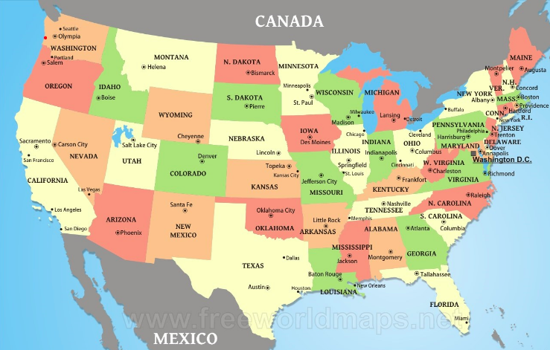
Congratulations to the State Hospice Organizations in the Trauma Informed Care Initiative
California
Utah
Texas-New Mexico
Louisiana-Mississippi
Georgia
North Carolina
South Carolina
Illinois
Ohio
New York State
Pennsylvania
Maine
Hudson Valley, NY
Pittsburgh
Cleveland
West Palm Beach
Salisbury

Slide 3
We Honor Veterans Needs Survey
180 Responding Hospice Programs
Does your organization?
1. Ask Veteran status?
2. Ask war era?
3. Screen for PTSD, Moral Injury and Suicide Intent?
4. Have the capacity to treat PTSD, Moral Injury and Suicide Intent?
5. See value in VA providing telehealth?
Summary of Responses
1. Largely “yes”
2. Largely “yes”
3. Evenly mixed “yes” and “no”
4. Majority “no”
5. Majority “agree” or “strongly agree”

Slide 4
Trauma Informed Care
The focus of this Congressionally funded initiative seeks to improve the care of Veterans on hospice that have been impacted by trauma
  Expand access to VA palliative tele-mental health expertise for Veterans on hospice in their homes
  Share VA’s expertise via the PTSD Consultation Program
    Please make your initial contact through WHV’s online form or by calling 800-646-6460
  Train community hospice staff in the care of Veterans on hospice

Slide 5
What I would like to present today
Our approach to improve the quality of end of life care for Veterans who die in VA facilities
  Acute care and ICU
  Community Living Centers
How we might use this approach to improve the end of life care of Veterans who have been impacted by trauma
Discuss our Brief Practice Guides for Emotional Support Prior to Death and Post Traumatic Stress Disorder as tools for QI

Slide 6
Key Performance Indicators for Palliative and Hospice Care in VA, FY 2019
Patient/Family Experience
Access
Community Partnerships
Bereaved Family Survey
(National mean % of families rating care as EXCELLENT or VERY GOOD)
88%
(vs 84% in FY16)
Growth in Outpatient Palliative Care
51,890
# Community Hospices in We Honor Veterans
4,058

Slide 7
VA National Bereaved Family Survey Scores
% Families reporting the care in the last 30 days of life as Excellent or Very Good

Slide 8
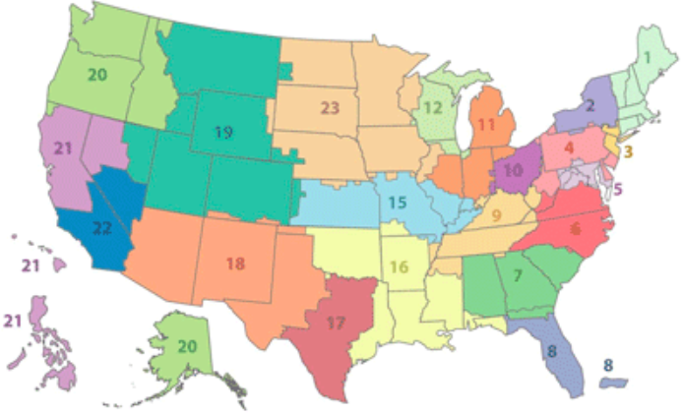
VA VISNs: Veteran Integrated Service Networks
Quality Improvement Collaborative Process
We meet with the PC Teams in each VISN twice per year
Review metrics
Share observations
Identify and implement quality interventions
Resources
  Peer mentoring
  Decision trees to focus QI
  Compendium of Best Practices
  Brief Practice Guides

Slide 9
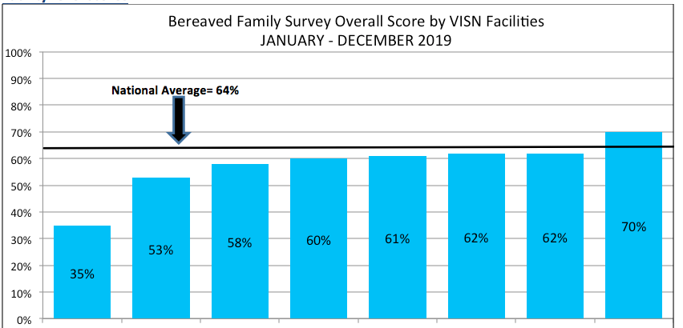
In VISN X, there is wide variation in the Facility BFS scores

Slide 10
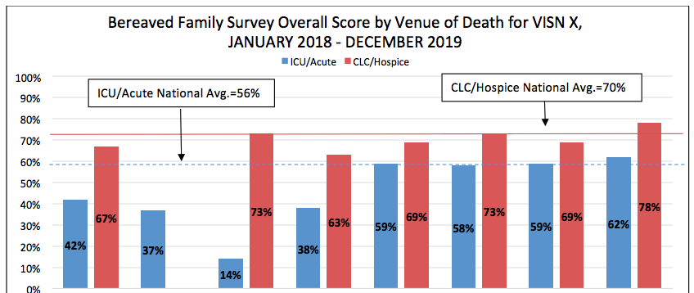
Breakdown of BFS scores for venue of death in VISN X
A
B
C
D
E
F
G
H
Facility C is above the national average in the CLC but well below in Acute/ICU

Slide 11
Breakdown of BFS scores for venue of death in VISN X
A
B
C
D
E
F
G
H
In VISN X, Facility H can serve as a mentor to Facility C

Slide 12
Breakdown of BFS scores for venue of death in VISN X
A
B
C
D
E
F
G
H
But how can Facility C focus their QI efforts and select an intervention?

Slide 13
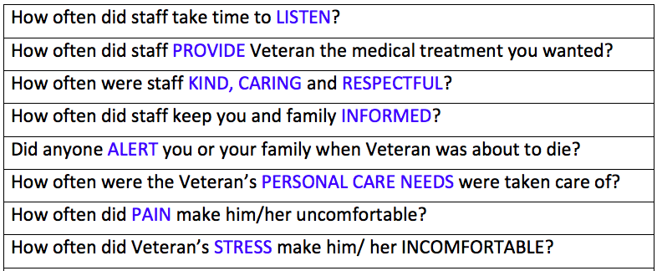
BEREAVED FAMILY SURVEY 16 questions
How can we focus our QI efforts and select an intervention?

Slide 14
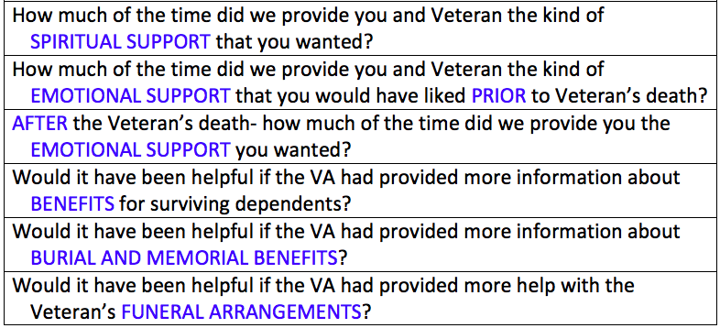
BEREAVED FAMILY SURVEY 16 questions
How can we focus our QI efforts and select an intervention?

Slide 15
The Decision Tree Analysis informs the PC Team where to focus their Quality Improvement efforts
The Veteran Experience Center uses machine learning techniques also known as ‘Decision Trees’ to identify the Bereaved Family Survey question that has the greatest potential to improve the family’s perceived quality of care at the end of life.
These key questions are reported out as the “Pathway to Excellence” by venue of death and facility.

Slide 16
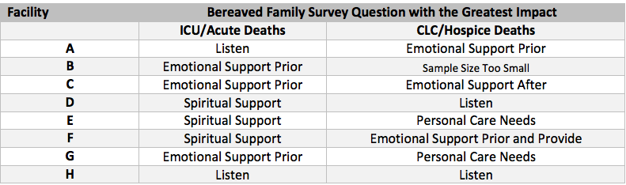
Decision Tree Analysis
Facility C can focus their QI efforts on improving Emotional Support Prior to Death in Acute Care and ICU

Slide 17
Compendium of Best Practices for the BFS
What Palliative Care Teams Recommend
Interviews with top-performing VA facilities for each question in the BFS
Identify Best Practices from 5 to 6 VA facilities
Describe the Best Practices in detail
Provide contact information for additional information and mentoring

Slide 18
Family Reported End of Life Practices from the BFS
What families have valued
Analysis of 1500 responses to two open-ended questions on the BFS:
  Is there anything else that you would like to share about [patient’s] care during the last month of life?
  Is there anything else that you would like to share about how the care could have been improved?
Practices were categorized into domains of end-of-life care by linking them to individual BFS questions

Slide 19
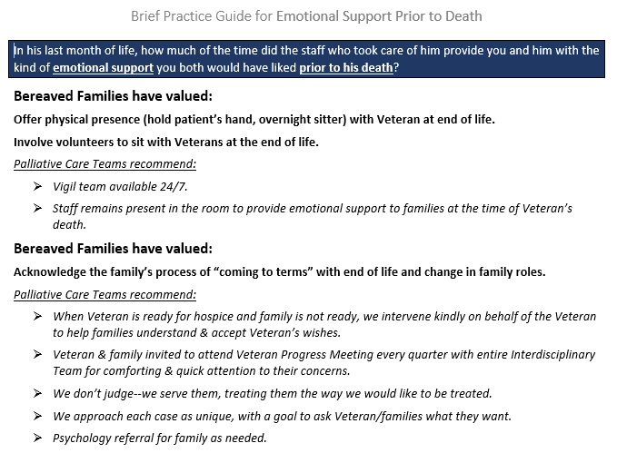
Brief Practice Guide for Quality Improvement
Emotional Support Prior to Death
Family Reported End of Life Practices
from the BFS
Bereaved Families have valued
From the Bereaved Family Survey
Compendium of Best Practices
PC Teams recommend
Family Reported End of Life Practices
from the BFS
Bereaved Families have valued
From the Bereaved Family Survey
Compendium of Best Practices
PC Teams recommend

Slide 20
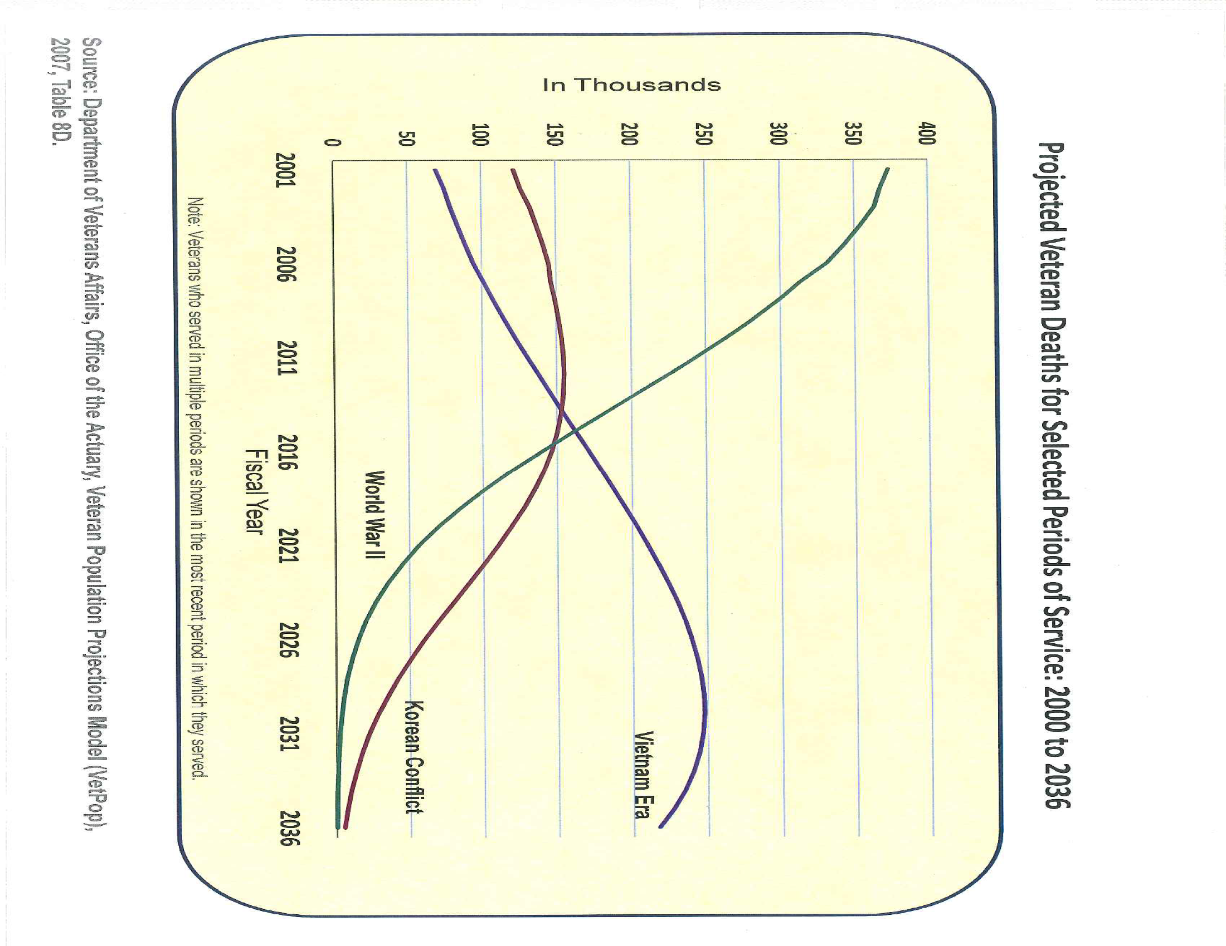
Our new challenge: Increasing Vietnam-era Deaths
2020

Slide 21
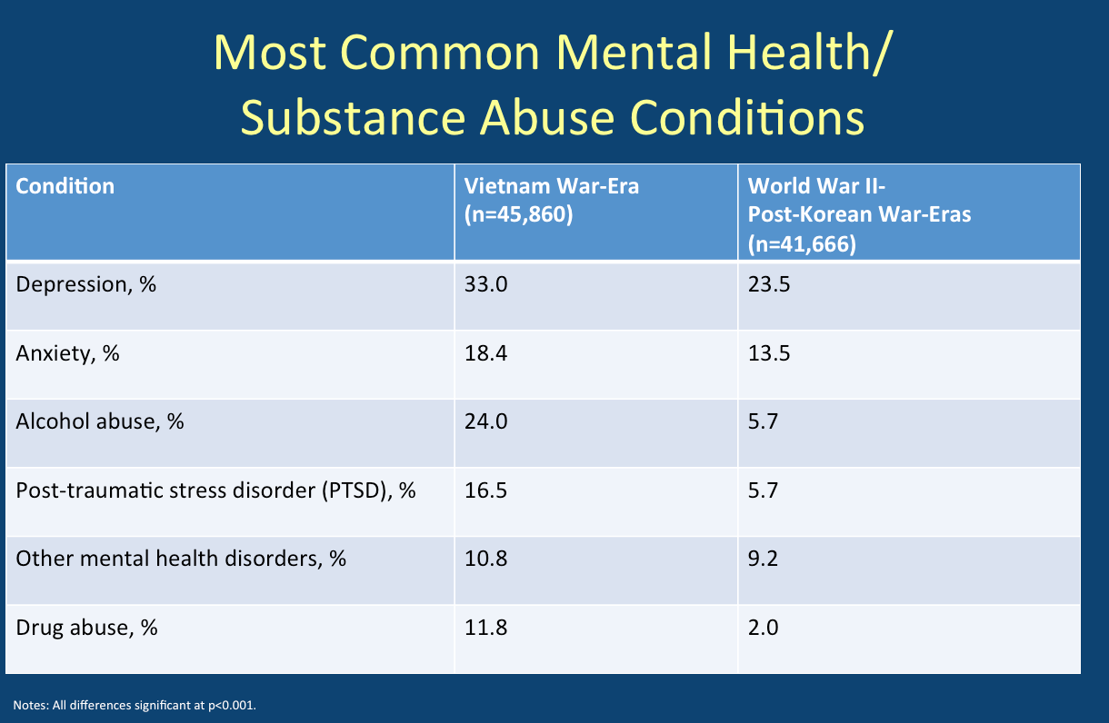
Quality of EOL Care for Vietnam-era Veterans NHPCO Webinar January 2020
Ann Kutney-Lee, PhD, RN, FAAN & Shimrit Keddem, PhD, MPH

Slide 22
Decision Tree Analysis of Vietnam Veterans with PTSD in Hospice
Baseline Overall Scores:
40.1% Not Excellent
59.9% Excellent
If Emotional Support Prior to Death is ALWAYS provided:
80.2% Excellent
19.8% Not Excellent
If Staff ALWAYS take time to Listen:
84.8% Excellent
15.2% Not Excellent
Takeaway: Always providing Emotional Support prior to death improves the family’s perception of Excellent care in the last month of life. To have an even greater impact, always Take Time to Listen to the Veteran and family.
If Emotional Support Prior to Death is
NOT ALWAYS provided:
73.4% Not Excellent
26.6% Excellent

Slide 23
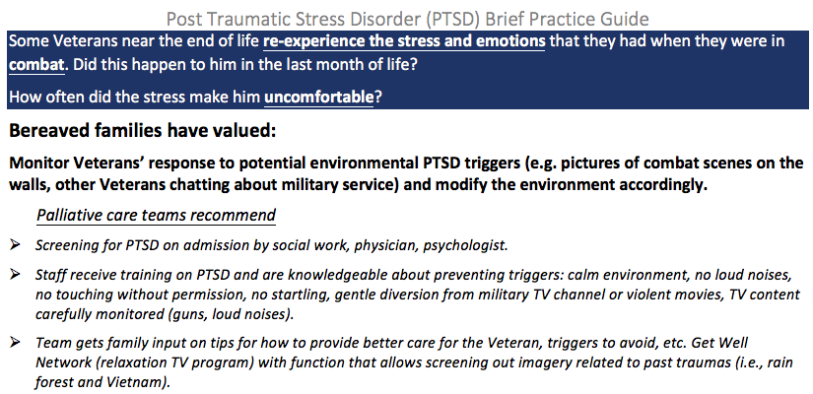
Brief Practice Guide
Post Traumatic Stress Disorder
Family Reported End of Life Practices
from the BFS
Bereaved Families have valued
From the Bereaved Family Survey
Compendium of Best Practices
PC Teams recommend

Slide 24
WHV and VA Trauma Informed Care Webinar
June 25, 2020
3:00 – 4:30PM
Trauma Informed Care and Rehabilitation
In Prison
Kandyce Powell RN, MSN
Executive Director, Maine Hospice Council

Slide 25
MHC History
Collaborative partnerships
Program development
Underserved populations
Prison Hospice Partnership – 2000
Hospice Veterans Partnership - 2004

Slide 26
Bureau of Justice statistics
According to an estimate by the Bureau of Justice in 2018, there are approximately 180,000 United States veterans in our prisons and jails.

Slide 27
Incarceration and PTSD
High burden of diseases typically associated with aging including cardiovascular disease, dementia, and autoimmune disorders.
Neyland, T. and Donovan, (2019)
Rates of PTSD and exposure to violence among inmates are much higher than in the general population.
          Miller, N. and Najavitis, (2012)

Slide 28
Institutional/Environmental Risks
Constant presence of authorities
Frequent discipline
Lack of privacy
Restricted movement
Pat downs
Strip Searches
Environmental noise
Sexual assault
Violence

Slide 29
End of Life in Prisons
Health care often neglected
Quality of life often not considered, nor respected
Prisoners often die alone
Symptoms often not addressed
According to Bureau of Justice statistics in 2018, 180,000 United States veterans reside in US prisons and jails.

Slide 30
Maine State Prison
It took 7 years to develop the infrastructure and trust necessary to develop the Hospice program.
Over 1,000 inmates at the maximum security facility.
The only infirmary in the state.
All male facility.
Women would be housed there when needing end of life care.

Slide 31
Trust
“Are you nervous?”
“Why?”
“Well, we’re in prison.”
“Well maybe I am a little bit.”
“I knew you would be!”
“Ask me why.”
“OK, why?”
“I’m not worried about you. I’m worried about why you would want to trust me?”
Silence

Slide 32
In the beginning: a Suggestion
“I have a suggestion. Would you be open to one?”
“Sure, let’s hear it.”
“I’ll put my humanity on the table. If you’re willing, you put yours right beside it. We’ll go forward together and see what an amazing Hospice Program we can develop and what amazing Hospice Volunteers you can become.”
“No doubt we’ll have our challenges. However, if we respect one another and the potential in all of us, the challenges can be overcome.”
“ What do you think?”
Everyone looked at each other and then all heads nodded in agreement.

Slide 33
Intersection with Veterans
Fifteen percent of population at MSP were Veterans
Five Veterans were caregivers in the Hospice program.
The first 4 patients cared for were Vietnam Veterans.
Many Veterans not on hospice sought consultation for their PTSD.

Slide 34
PTSD
Fear
Anger
Guilt
Shame
Anxiety
Emotional numbing
Dissociation
Hyper-vigilance/responsiveness
Withdrawal
Trust
Inability to forgive

Slide 35
Morals - definition
Assumptions about how things should happen in the world and how people should behave.
Trauma can destroy these assumptions.

Slide 36
Impact
In altruistic service to others, both caregivers and patients experienced healing
Rehabilitative
Learned love and forgiveness through altruistic service.
Some of the finest caregivers I’ve ever worked alongside.
Some of the most profound work in my life.

Slide 37
Thank You!
For more information: kpowell@mainehospicecouncil.org

