Slide 1
Addressing Trauma and its Impact
Improving Hospice Care
in Nursing Homes
for Veterans, family, and staff
Adapted from:
ELNEC for Veterans Curriculum (End-of-Life Nursing Education Consortium)
&
Palliative Care Nursing Assistants Curriculum
Hospice and Palliative Nurses Association

Slide 2
Key Learning Objectives
Upon completion of this module, the participant will be able to:
Discuss the impact of military service, gender, and age on communication
Identify methods of therapeutic communication with Veterans and their families
Discuss how to deal with manifestations of trauma or moral injury

Slide 3
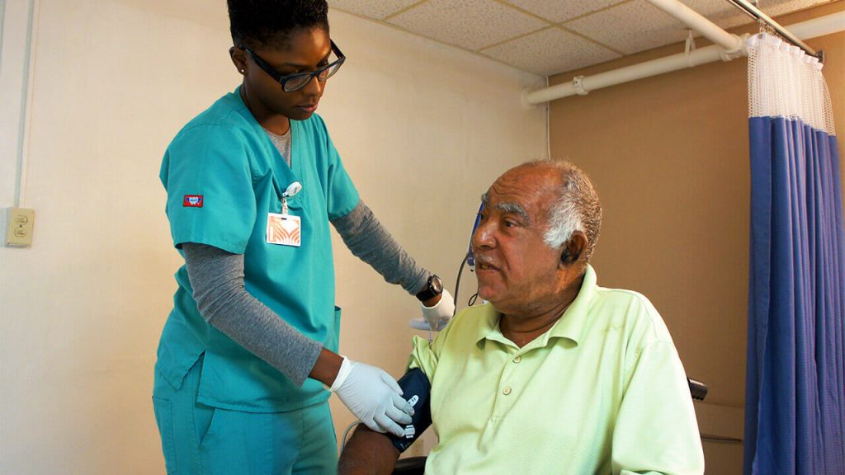
Basic Concepts of Communication
Sending and receiving
Verbal communication
Non-verbal communication
Physical appearance
Actions
Facial expressions
Silence
Presence
Working as a team - communicate concerns
This can be rewarding work - the hug of a lifetime

Slide 4
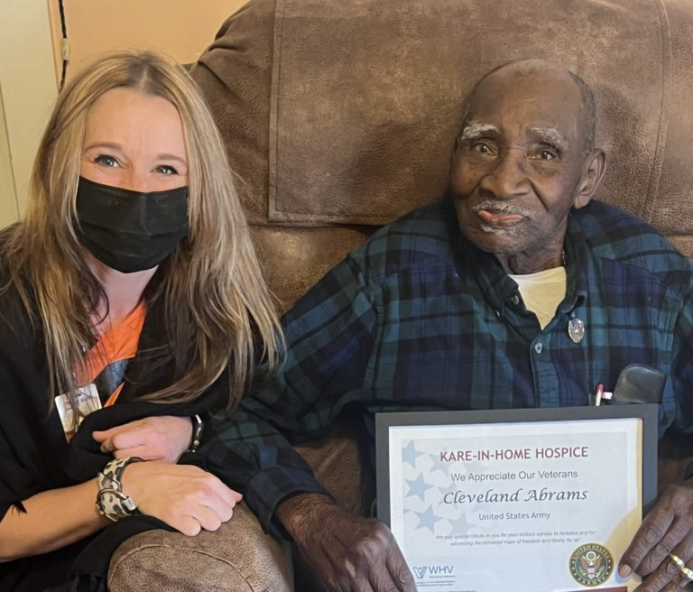
Listening
Receiving, paying attention to, and making meaning – an active process
Stop talking
Take time
Nonverbal communication

Slide 5
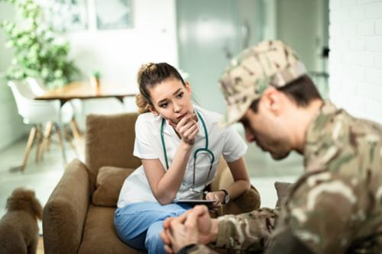
Speaking
Introduce yourself
Speak slowly, clearly, unhurriedly
Use familiar words and simple sentences
Avoid distracting behaviors
Repeat ideas if necessary
Your nonverbal communication

Slide 6
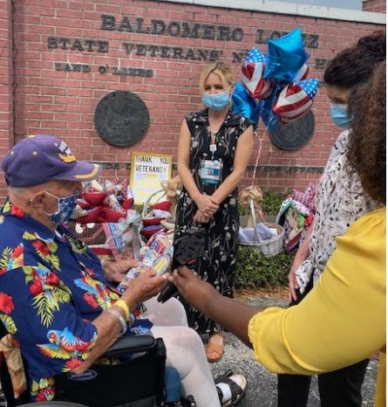
Cultural Differences
Variations in rules of communication
Meaning of words
How death is discussed
Avoid stereotyping, ask for clarification

Slide 7
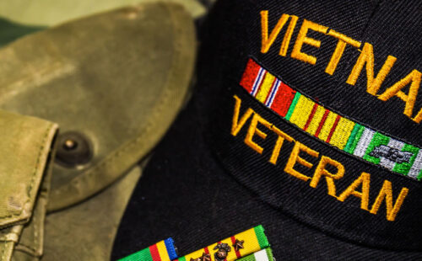
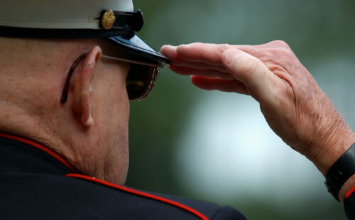
Veteran Culture
All Veterans experienced military culture
Stoicism
Effects of combat and exposure to violence

Slide 8
War Era Differences
World War II
1939-1945
Korean War 1950-1953
Vietnam War 1961-1975
“Greatest Generation”
“Forgotten War”
Better battlefield care
Agent Orange Exposure
Mistreated when returned

Slide 9
War Era Differences
Gulf War
1990-1991
OIF/OEF (Iraq & Afghanistan)
Exposure to environmental toxins
Increase in depression and traumatic brain injury (TBI)
Multiple disabilities

Slide 10
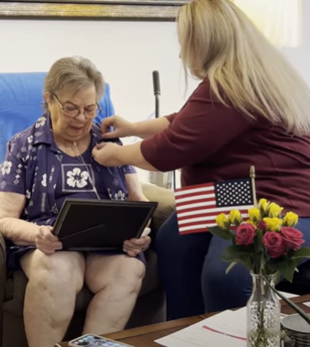
Influence of Gender and Age
Culturally common to show respect to older adults
Many older female Veterans may experience their service overlooked
Consider hearing and vision problems

Slide 11
Therapeutic Communication
Be prepared – stories may be shared when you least expect it
It’s okay to say “I don’t know”
Do not rush communication
Respect privacy
If asking a sensitive question, explain why you are asking

Slide 12
Manifestations of Trauma
Some Veterans live with Post Traumatic Stress Disorder
Exposed to violence or perceived threat(s) to one’s life
Intrusive thoughts about the trauma
Nightmares

Slide 13
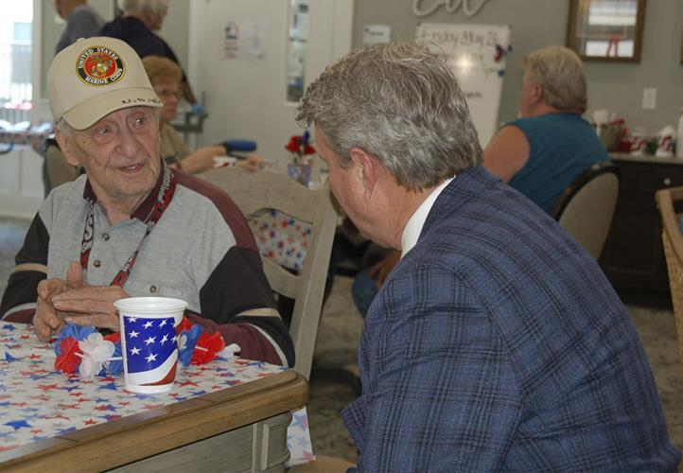
Moral Injury
Some Veterans live with Moral Injury
A sense of guilt or shame about a behavior that is inconsistent with one’s moral code
Can be difficult to talk about
Risk being judged or rejected

Slide 14
Messages to Communicate
“I will listen to you”
“I will be honest and truthful”
“I will not abandon you”
“I value you as a person”
“I will respect your values and goals and help you to achieve those goals as much as I am able”

Slide 15
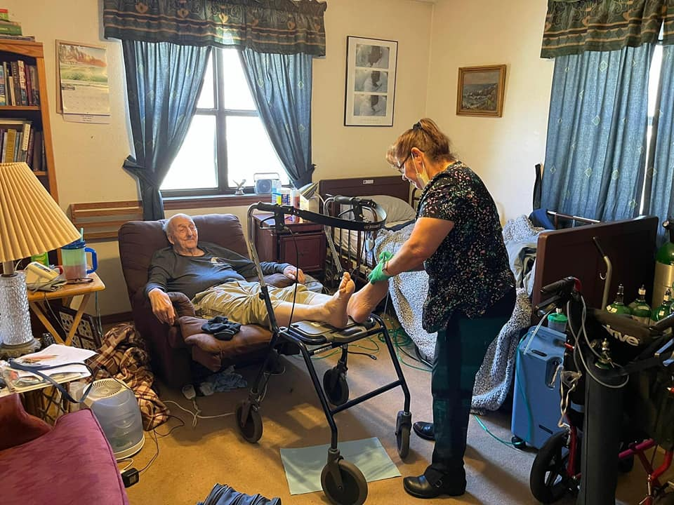
Supporting Veteran and Family
Any environmental stressors?
Does Veteran do better with clear announcement of who is about to enter room?
Has family considered PTSD or moral injury before?
Maybe take irritability or aloof behaviors less personally

Slide 16
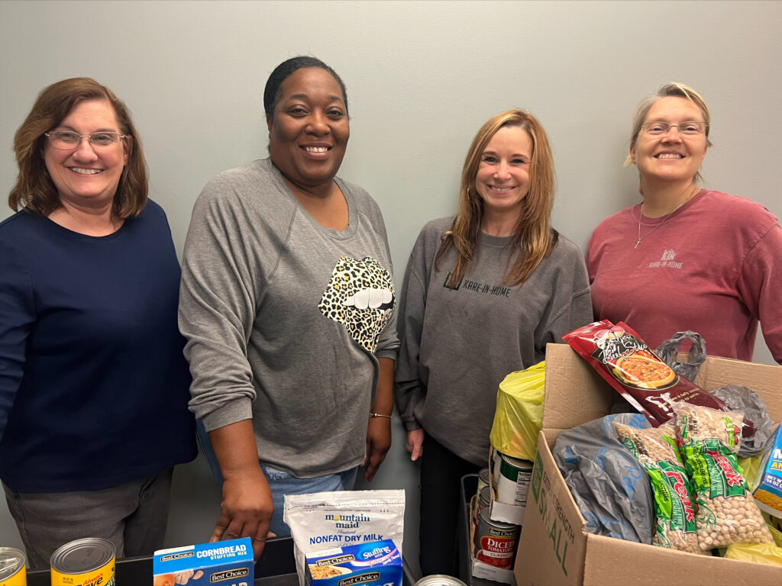
Work with Team
Share observations or conversations with Nursing Assistant/Caregiver or hospice team
Chaplain or social work visits may be indicated for further discussion
Value all roles on the team
Continue to take excellent care of the Veteran

Slide 17
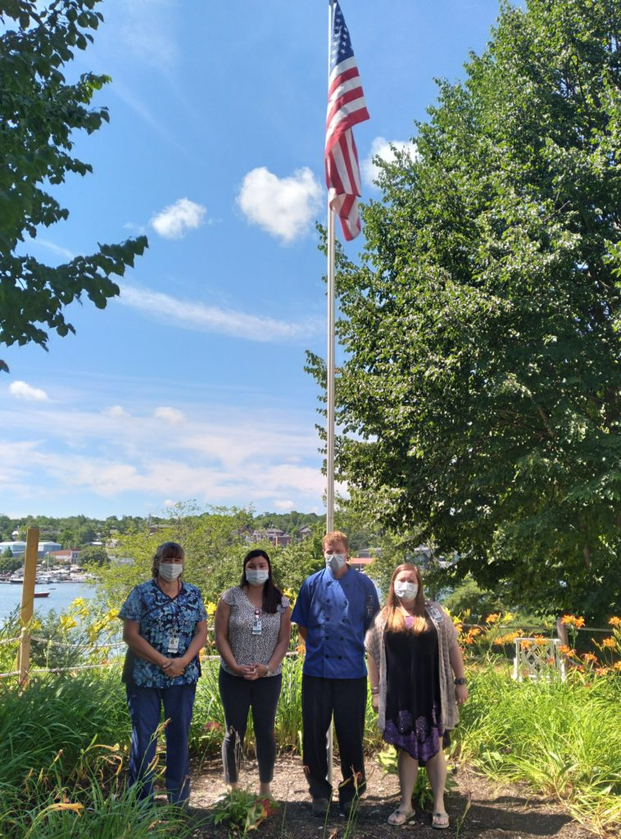
Managing Your Own Stress
Are you feeling irritable, fatigued, emotionally withdrawn?
Take care of personal relationships
Recognize and support your own emotional and spiritual needs
Trust in your team
“Even Superman was Clark Kent most of the time”

