Slide 1
Caring for Veterans in their Final Hours
Improving Hospice Care
in Nursing Homes
for Veterans, family, and staff
Adapted from:
ELNEC for Veterans Curriculum (End-of-Life Nursing Education Consortium)
&
Palliative Care Nursing Assistants Curriculum
Hospice and Palliative Nurses Association

Slide 2
Key Learning Objectives
Upon completion of this module, the participant will be able to:
Identify the common signs and symptoms of the dying process.
Provide supportive comments for Veterans and their families.
Appreciate the fulfillment from quality care at end of life.

Slide 3
NCP Guidelines
Domain 7: Care of the Patient Nearing the End of Life
Care for patients and families with an emphasis on the days leading up to and just after the death of the patient.
Assessment & management of distressing symptoms.
Knowing what to expect with approaching death.

Slide 4
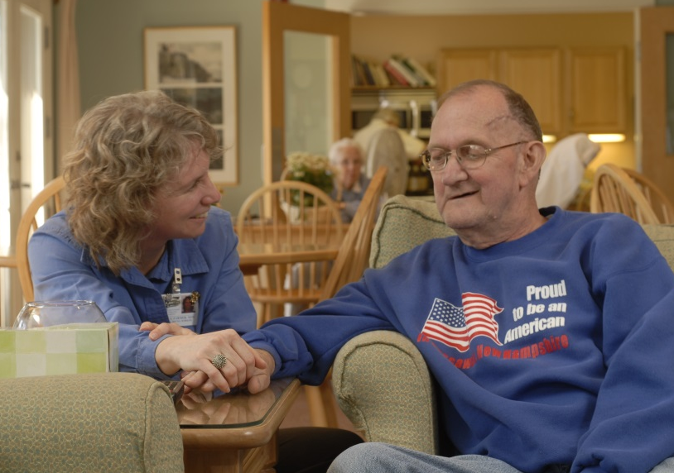
Preparing for a Good Death
The importance of the nurse (at the bedside)
Attentiveness, compassion and concern (“eyes” and “ears” for the patient)
Respecting values (each death is unique)
Working as a team (communicate concerns)
This can be rewarding work (the hug of a lifetime)

Slide 5
The Nurse, Dying, and Death
Nurses provide support
“this must be overwhelming”
Interpersonal competence
“you look like you are in pain?”
Being present
“may I call the Chaplain?”
Interprofessional care
“I’m concerned he’s uncomfortable”
Nursing Assistant Perspective Video
https://www.youtube.com/watch?v=1Q7_VQ815fU

Slide 6
Open & Honest Communication
Caring, sensitivity and compassion:
“may I moisten your mouth with some water?”
Provide information in simple terms:
“he’s sleeping more but seems comfortable”
Awareness of dying:
“what are your concerns about what’s coming?”

Slide 7
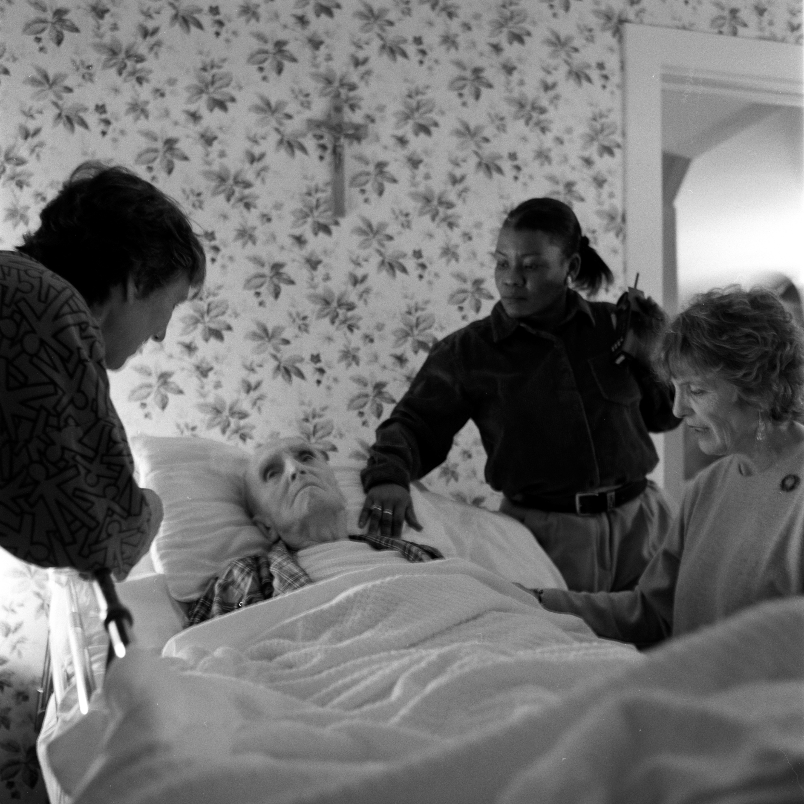
Dying is an Individual & Personal Experience for the Veteran
!
!
There is no typical death.
Veterans may be reluctant to express pain
Perceived as weakness
Thoughts of previous trauma may intrude
Assure safety, especially before touching

Slide 8
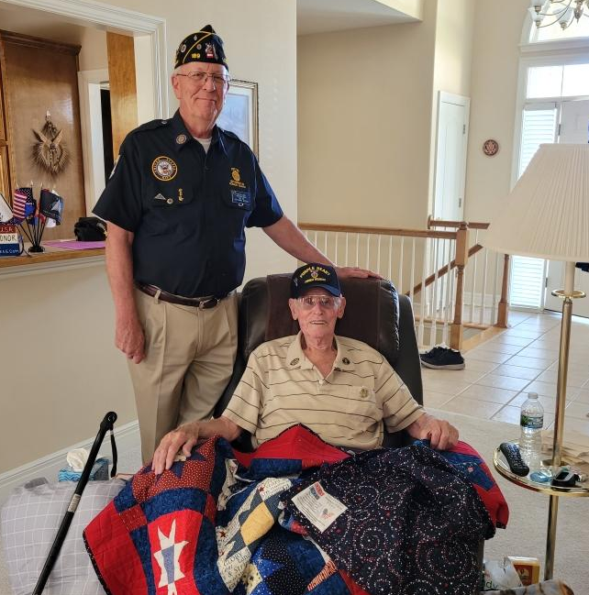
Environment = Veteran’s Bedroom
Sacred space (but also your workspace)
Give the patient a sense of control
“May I move these pictures over here?”
Family space
Near the patient and a separate quiet area

Slide 9
Staff Behaviors
Frequent visits (balance privacy and support)
Sit down when able
Listen- actively!
“Being there” - can be more important than words

Slide 10
Common Symptoms Vary
Common symptoms can include:
Pain
Shortness of breath
Declining appetite/difficulty swallowing
Restlessness
Intermittent confusion, hallucinations
Noisy “wet” respirations
Purplish coloring of skin- feet, knees, lips
Shallow breathing, pauses

Slide 11
General Comfort Care
Mouth Care includes:
Rinse mouth frequently with water
Saliva substitutes
Lip lubricant
Keep teeth, dentures, and bridges clean
Small amounts of fluid

Slide 12
Pain
Nursing Interventions:
Individual approach: “what’s helped in the past?”
Reposition frequently
Non-drug pain therapies: Human touch & Music
Medications – to include “as needed”

Slide 13
Shortness of Breath = Dyspnea
Nursing Interventions:
Positioning
Move slowly
Direct fan to the face and/or open window to move air
Use relaxation or distraction techniques (e.g., music)
Medications - to include “as needed”

Slide 14
Restlessness
Nursing Interventions:
Speak in a quiet, natural way
Verbally prepare Veteran for care
Calming effect
PTSD triggers (e.g., avoid loud noises)
Do not interfere with or try to restrain, unless the patient is harming him/herself

Slide 15
Use of Morphine-like drugs in the Final Days/Hours
Dosing adjusted incrementally to address pain and shortness of breath.
Comfort is the goal, not to shorten life.
Consider other routes when needed:
Subcutaneous
Rectal
Transdermal

Slide 16
Sitting Bedside
Family presence- promote this and provide support (e.g., snacks, recliners…)
Common fears- prepare family for what’s to come as death approaches
e.g., family brochure

Slide 17
Support for the Family
Common family fears at time of dying:
Being alone
Painful death
Watching person suffer
Not knowing when the person is dead
Causing the person’s death

Slide 18
Care After Death
Family participation as desired
Say your own “good-byes”
Prepare family for removal of the body
A time the family will remember
Consider doing a “Final Salute” ceremony

Slide 19
Final Salute
Watch video of a Final Salute
More info:
Ensuring Veterans Receive a Hero’s Final Salute https://www.ncbi.nlm.nih.gov/pmc/articles/PMC9217076/
https://www.youtube.com/watch?v=1PE1Zvt2kSc

Slide 20
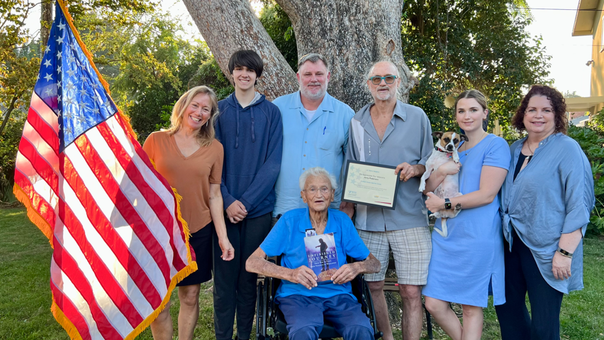
Conclusion
Family members will always remember the last days, hours, and minutes of their loved one’s life.
Nurses have a unique opportunity to be invited to spend these precious moments with them and to make those moments memorable in a positive way.

