Slide 1
Ceremonies to Honor and Remember
Improving Hospice Care
in Nursing Homes
for Veterans, family, and staff
Adapted from:
ELNEC for Veterans Curriculum (End-of-Life Nursing Education Consortium)
&
PsychArmor’s “15 Things Veterans Want You To Know” and
“Caring for Veterans Through End of Life: Healthcare Providers”

Slide 2
Key Learning Objectives
Upon completion of this module, the participant will be able to:
Know the process of a pinning ceremony
Recognize the role of the interprofessional team and the family unit in honoring Veterans, loved ones, and ceremonies of remembrance

Slide 3
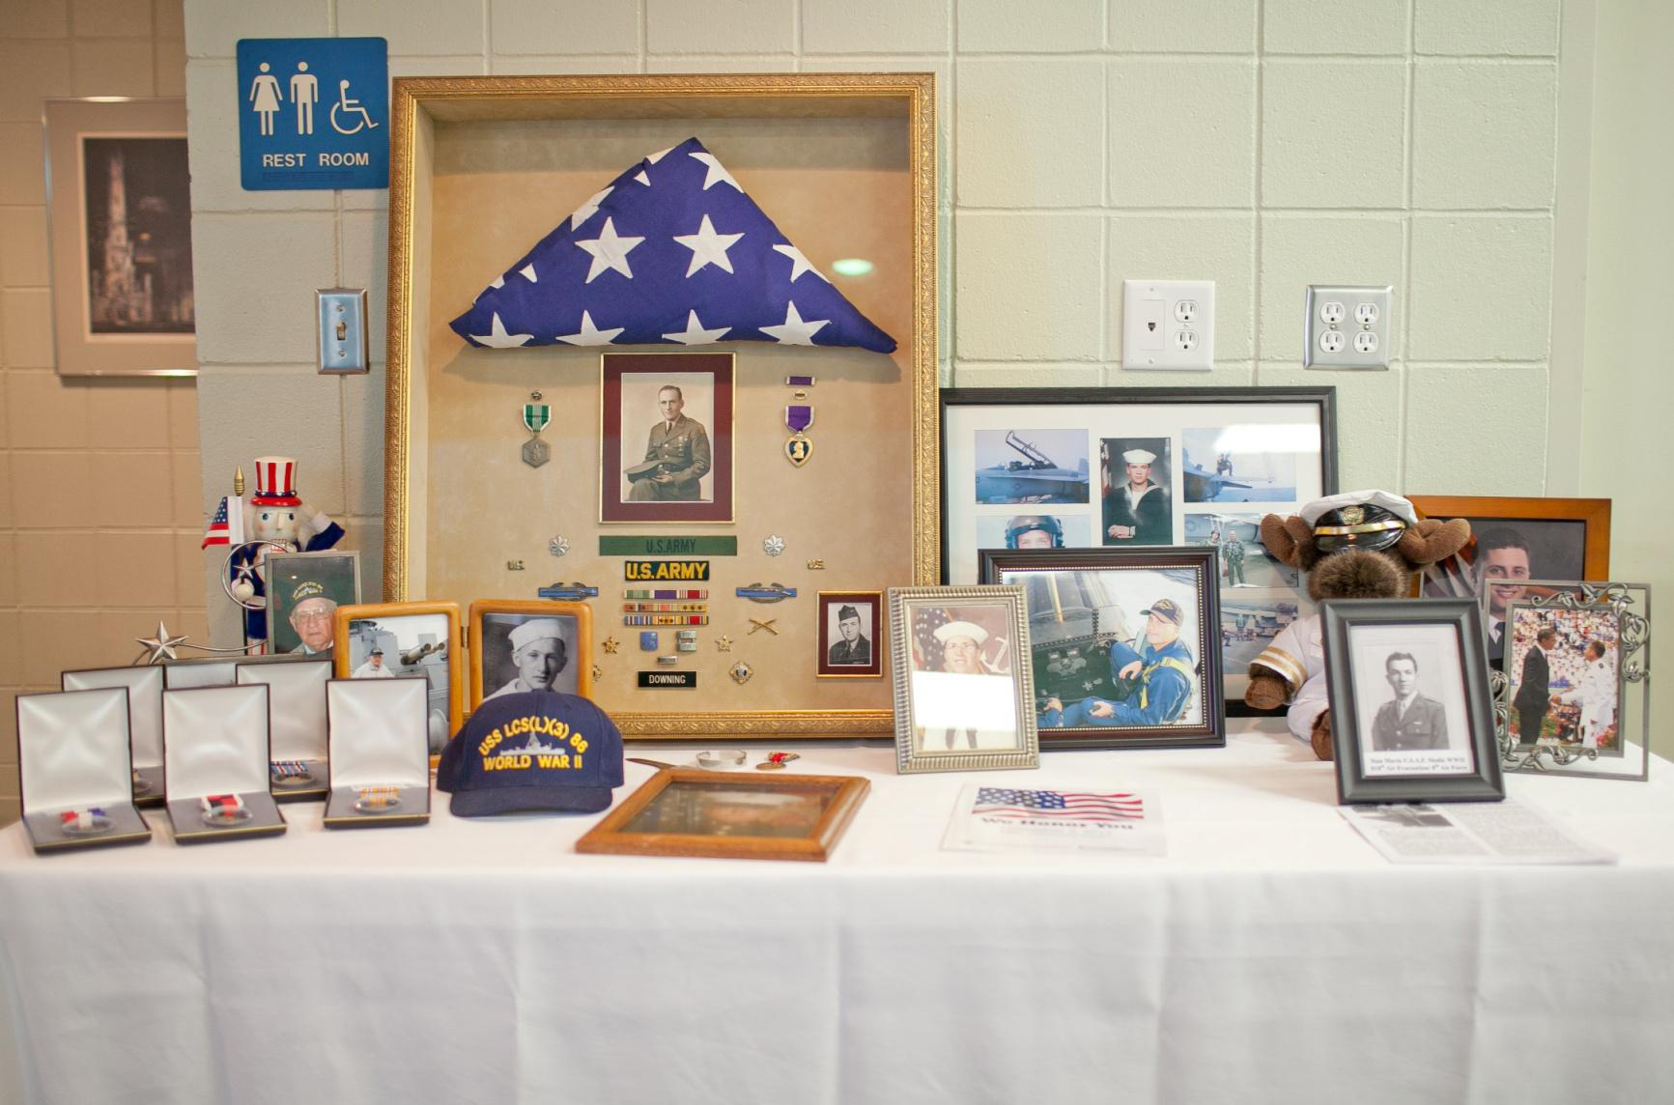
Honoring Veterans and Their Loved Ones

Slide 4
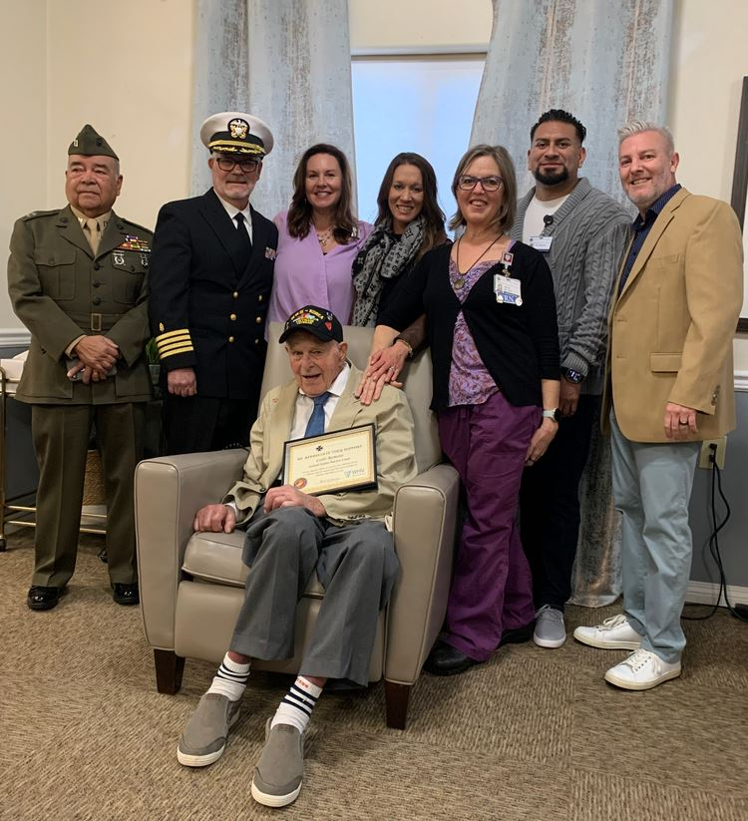
Purpose of Salutes and Pinning Ceremonies
Recognizes and pays tribute to Veterans for their service to their nation
Encourages Veterans to share their personal experiences and stories
Provides an opportunity to be reunited with active-duty service personnel
Promotes camaraderie among residents in Nursing Homes
Acknowledges the military service and sacrifices made by both the Veteran and their family

Slide 5
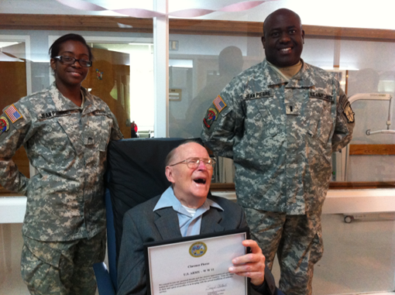
Settings
First, always check Veterans’ preferences for pinning
Can be impromptu or planned
If planned
Coordinate to allow family and caregivers to be present
Involve family and other significant people in the Veteran’s life
At the Veteran’s bedside
Can also be held in community area or meeting room as appropriate

Slide 6
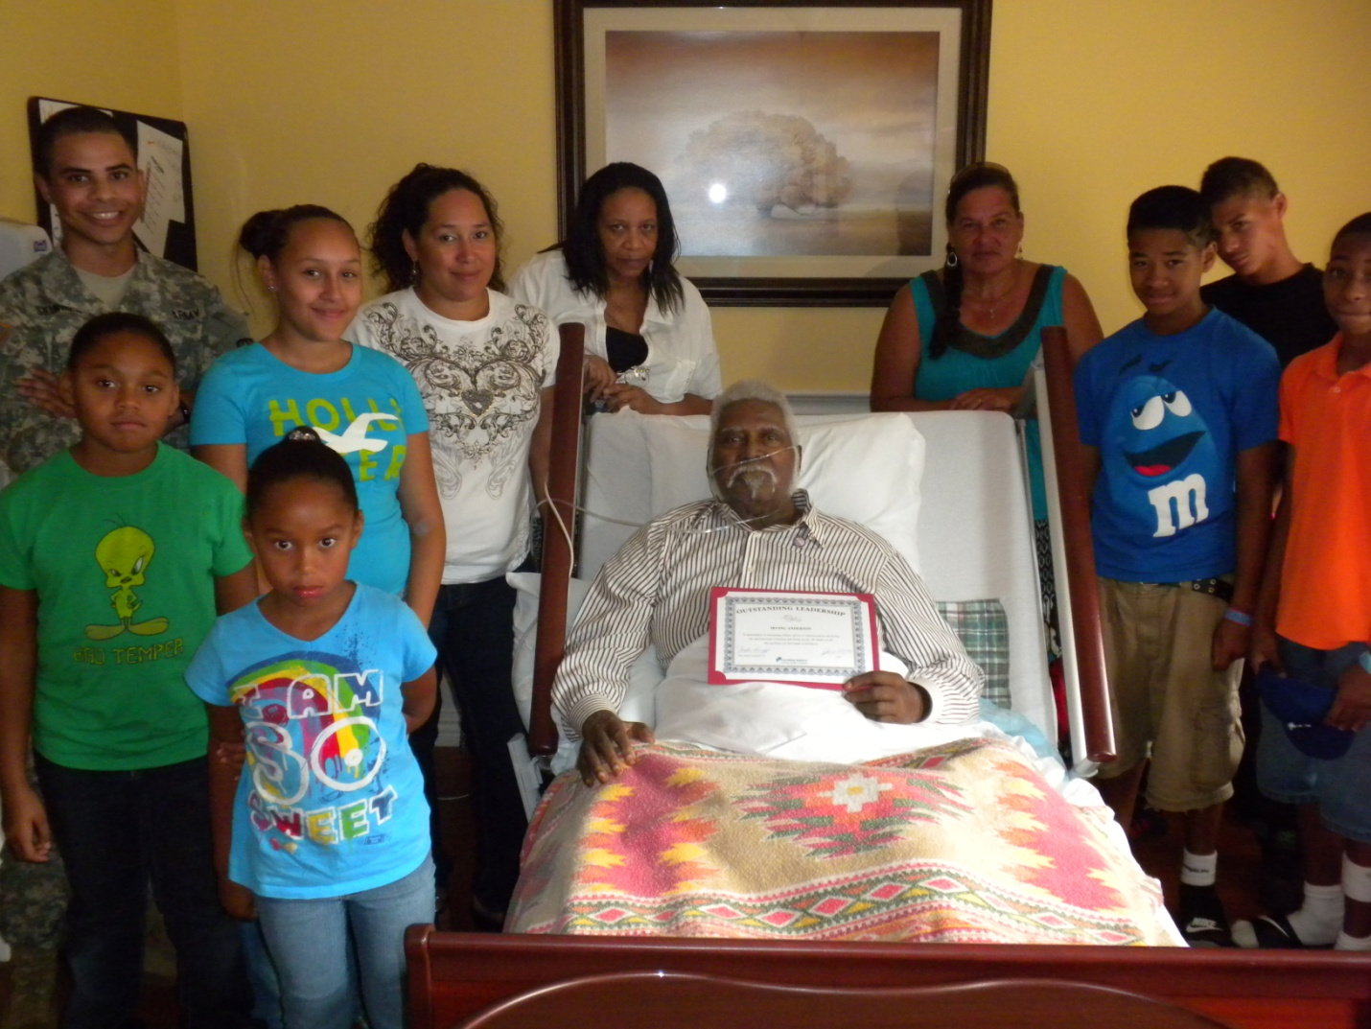
Purpose of Memorials
Provides an opportunity for family, caregivers and staff to honor and remember Veterans who have died
Promotes healing and recovery during the grieving process

Slide 7
Settings
First, always check Veterans’ family member preferences
Peaceful setting such as a private park with outdoor pavilion near a lake or pond
Facility activity room, fellowship hall, community center or meeting room
Can also be held in community area, activity room, or meeting room as appropriate
Timing can be twice a year (Spring and Fall) or on Military holidays
Memorial Day
Veterans’ Day
Armed Forces Day
Pearl Harbor Day
Independence Day

Slide 8
Pinning Ceremonies

Slide 9
Pinning Ceremonies (continued)

Slide 10
Pinning Ceremonies (continued)
Notes:
Pinning Ceremony by a Chaplain and US Air Force Veteran

Slide 11
Pinning Ceremonies (continued)

Slide 12
Organization Name
We Appreciate Our Veterans
Veteran’s Name
United States Army
We pay special tribute to you for your military service to America and for
advancing the universal hope of freedom and liberty for all.
INSERT
ORGANIZATION
LOGO HERE

Slide 13
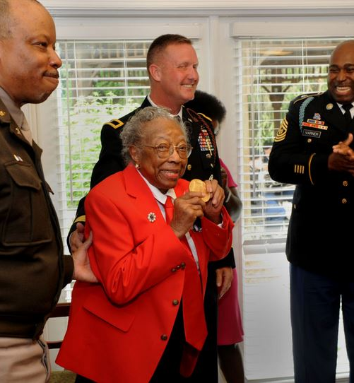
Resources
Certificates for each branch
Overview and suggested script
Certificates for Spouses and Children
All available in Spanish
Resources available here

Slide 14
“They gave him a certificate, congratulating him on being a Vet and that they appreciate everything he's done, and they gave him a little stick pin with a flag on it. It was about a month after we got hospice coming in and they surprised him with this certificate…he's got it sitting there where he can see it all the time. Tears came to his eyes because the Vietnam Vets - they were mistreated so bad when they come back from Vietnam. My husband tells me some of the stuff and he just appreciated that they know what the Vietnam Vets went through back then.” ~Army Veteran Spouse/Caregiver

