Slide 1
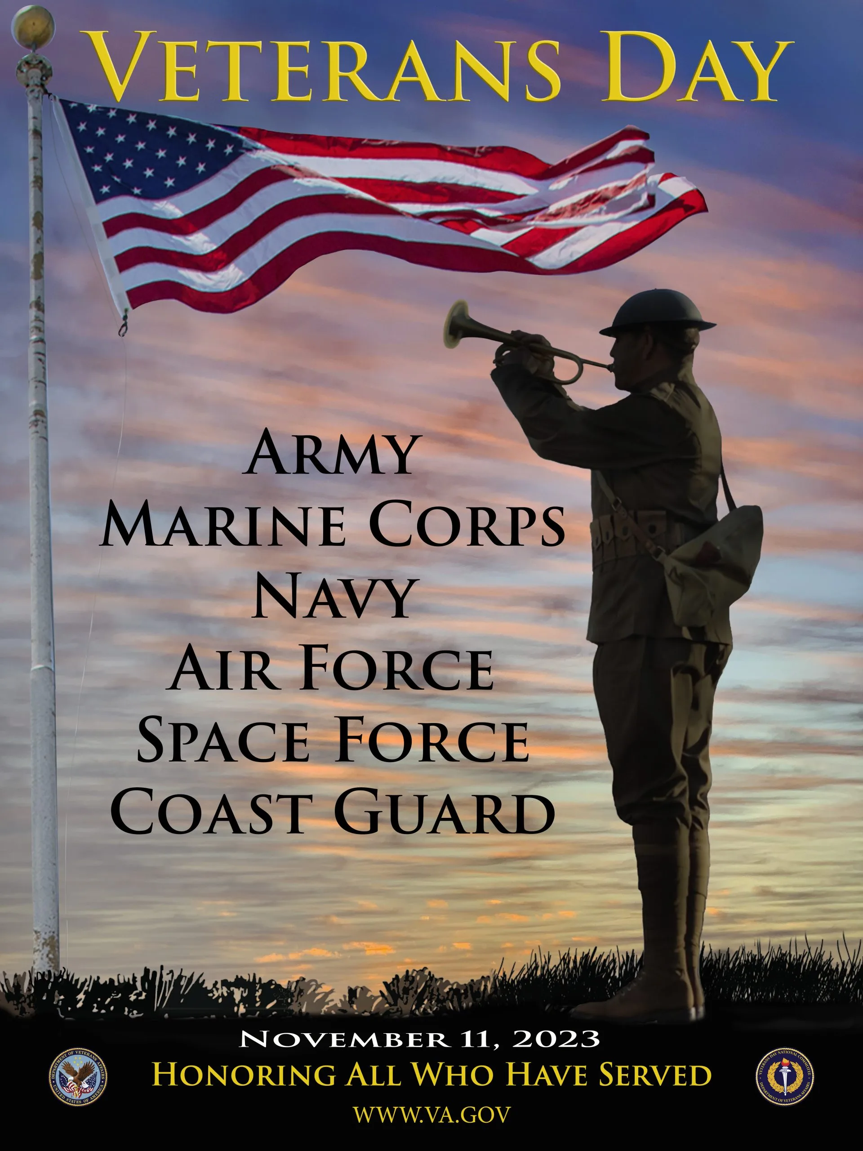
Overview for Frontline Staff and Supervisors
Improving Hospice Care
in Nursing Homes
for Veterans, family, and staff
Adapted from:
ELNEC for Veterans Curriculum (End-of-Life Nursing Education Consortium)
&
PsychArmor’s “15 Things Veterans Want You To Know” and
“Caring for Veterans Through End of Life: Healthcare Providers”

Slide 2
Key Learning Objectives
Upon completion of this module, the participant will be able to:
Identify dimensions of military culture
Have an understanding of what questions to ask Veteran patients
Know the process of a pinning ceremony
Recognize the role of the interprofessional team and the family unit in honoring ceremonies

Slide 3
Before we get started…

Slide 4
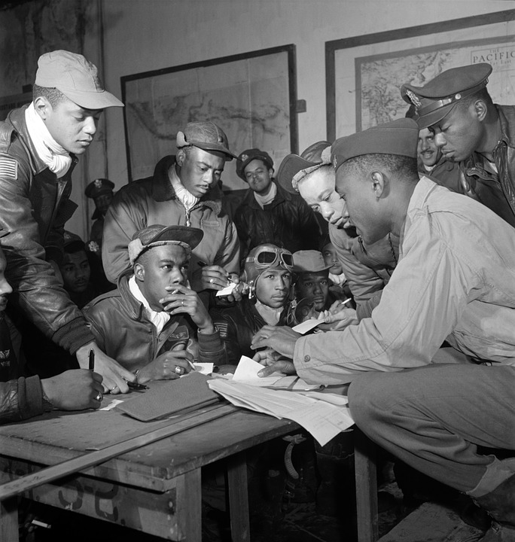
When asking about military history
Many Veterans don’t call themselves Veterans. They reserve that title for those Veterans who are service-connected for injuries or who have been in combat. Instead of asking a patient if he or she is a Veteran, ask:
“Have you served in the military?”
When asking about military history ask open-ended questions that give the Veteran control over how much or how little they choose to reveal.
“Tell me a little bit about how things went for you in the military.”
“How did your experiences in the military mold and shape your life?”
Excerpt from Deborah Grassman’s book, Peace At Last, Stories of Hope and Healing for Veterans and Their Families

Slide 5
Military Culture
Unique American Subculture
Branch of Service
Rank
Service type
Occupational specialty
Deployments
Era of service

Slide 6
Armed Forces Subcultures

Slide 7
Cultural Demographics
Population decreasing (12 million in 2045)
Veteran population is younger

Slide 8
Veterans by Period of Service
Gulf War 1990-2001 20.7%
Korea 1950-1953 8.1%
World War II
1939-1945 3.5%
Vietnam era 1961-1975 35.7%
Gulf War 2001 and later 19.3%
US Census, 2021

Slide 9
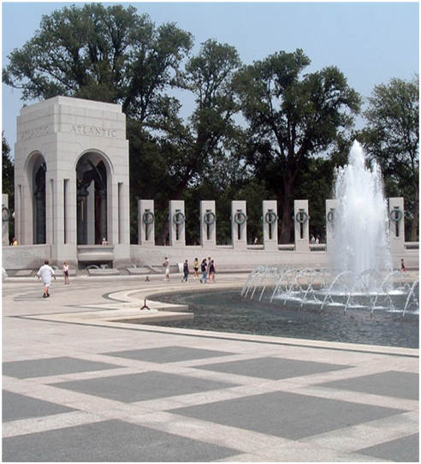
Cultural Demographics: Different Wars
World War II: 1941-1945
Enthusiastically supported by Americans
Veterans came home as heroes
Korean Conflict: 1950-1953
Never officially declared a war
“Forgotten war”, Veterans’ trauma minimized/neglected
Cold War: “Atomic Veterans”
Considered 1945 till 1990s
Veterans exposed to radiation

Slide 10
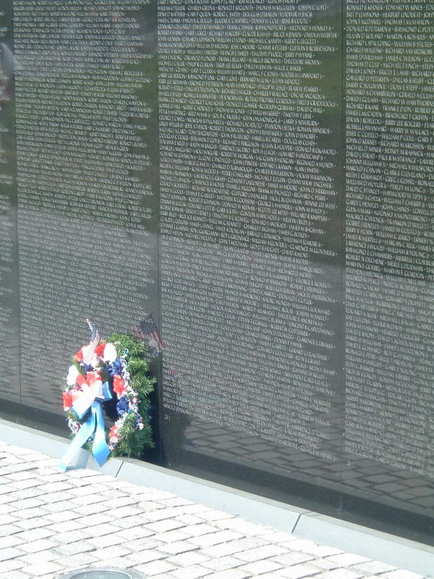
Cultural Demographics: Different Wars (continued)
Vietnam War (largest group of Veterans)
Veterans were not welcomed home
Anti-war protests
Tragedy of war: toxic exposures (AGENT ORANGE)

Slide 11
“I always tell everybody I can spot a Vietnam Veteran a mile away just because they stand out ... I absolutely love working with them, but there certainly are challenges. There is a distinct culture with that specific population of Veterans…they differ from World War II and Korea because when a lot of these guys came out, they hid that they were Veterans because of the way they’d be treated. They weren't given jobs. There wasn't like that community support when they came back home, you hear that a lot. Some of them were compared to murderers, to Nazis as one patient told me.” ~Hospice Caregiver

Slide 12
Cultural Demographics: Different Wars (continued)
Gulf War
Greeted home as heroes
Concerns about toxic agents
Operation Enduring Freedom (OEF)/Operation Iraqi Freedom (OIF) – Operation New Dawn (OND)
Longer and multiple deployments
Environmental and traumatic injuries

Slide 13
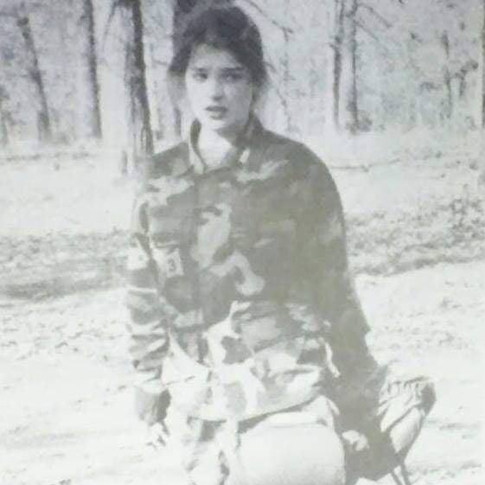
Cultural Demographics: Women Veterans
Veterans (VA, 2019)
10% of Veteran population
Fastest growing group in the Veteran population
I Am Not Invisible (IANI) campaign
More challenging to identify women Veterans
Women Veteran Program Managers at all VA Facilities

Slide 14
LGBTQ Veterans
Prior to 1982 criminalized and discharged
1993 Don’t Ask Don’t Tell
2011 openly gay, lesbian and bisexual people allowed to serve in military
Family structure
VA Facility LGBTQ coordinators

Slide 15
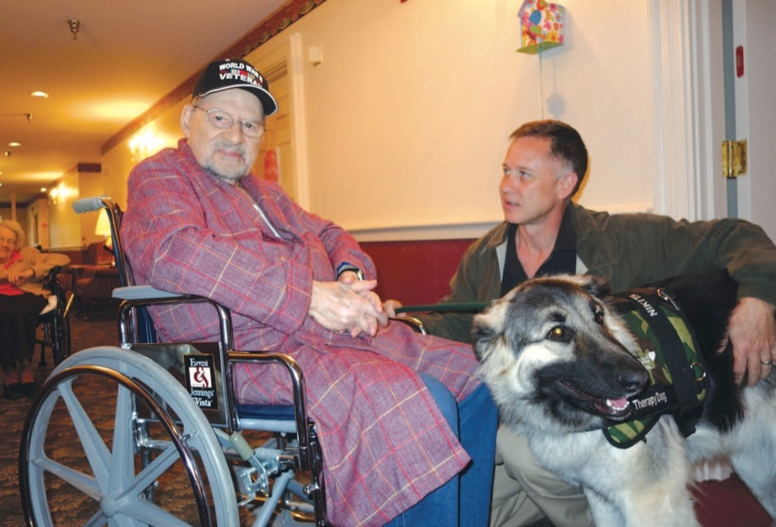
Cultural Considerations of Communication
Safe space
Conversation style
Personal space
Eye contact
Touch
View of healthcare professionals
Learning styles
Use of interpreters

Slide 16
Additional Resources: PsychArmor Training Videos

