Slide 1

Trauma-Informed Care: Screening and Referral of Veterans on Hospice
November 16, 2021

Slide 2
Presenters (in order of presentation):
Jordana Meyerson, MD, VA Palliative Care Physician, Boston, MA
Mandy Anderson, LMSW, Heart of Hospice
Sadie Larsen, PhD, VA Psychologist, Milwaukee, WI & National Center for PTSD
Douglas Lane, PhD, VA Geropsychologist, Tacoma, WA
Fanta Gibson, LCSW, CDP, VA Palliative Care Coordinator, Danville, IL

Slide 3
Polling questions

Slide 4
Objectives
The learner will be able to…
1) identify and incorporate at least 2 questions to screen for distress related to Post-traumatic stress disorder (PTSD) and moral injury.
2) apply the techniques learned in this training to assess the spectrum of severity of distress related to PTSD or moral injury to determine the appropriate levels of intervention (e.g., psychological first aid, PTSD Consultation Program, VA telemental health referral).
3) identify and apply the steps needed to connect Veterans with significant suffering from PTSD or moral injury on home hospice to VA telemental health expertise.

Slide 5
Setting the stage

Slide 6
Approach care assuming your patient has a history of trauma
Psychological trauma is common in the general population, with prevalence of up to 90% across the life span.
Military veterans are at further risk of post-traumatic stress disorder (PTSD). 30% of Vietnam veterans, 12% of Gulf war veterans, and 11-20% of Operation Enduring Freedom/Operation Iraqi Freedom (OEF/OIF) veterans are estimated to have had PTSD at some time in their lives.
PTSD might impact the dying process through PTSD symptom exacerbation, distrust of providers, avoidance of medical care, and evoking of negative feelings upon life review.
Trauma-informed care requires tailoring of interventions to mitigate the effects of trauma as patients experience life-limiting illnesses.
Ganzel 2018; Antoni et al 2012; Feldman et al 2006
Principles
Safety
Peer Support
Collaboration & Mutuality
Cultural, Historical, & Gender Issues
Trust & Transparency
EmpowermentVoice, & Choice

Slide 7
Trauma can overwhelm the ability to cope well
Principles
Safety
Peer Support
Collaboration & Mutuality
Cultural, Historical, Gender Issues
Trust & Transparency
Empowerment, Voice, & Choice
Substance Abuse and Mental Health Services Administration 2014

Slide 8
Many interventions for treatment of PTSD might not be appropriate at end-of-life
Stage 1 (Immediate)
Palliate immediate discomfort and provide social support
Stage 2 (Short-term)
Provide psychoeducation and enhance coping skills
Stage 3 (Long-term)
Treat specific trauma issues
Palliate immediate discomfort and provide social supports
Active listening and reassurance
Direct assistance in solving practical problems
Work with providers and loved ones to avoid triggering PTSD symptoms
Mediate discussions with providers and loved ones
Feldman et al 2014

Slide 9
Community Hospice Perspective

Slide 10
How do I connect this in the field?
During In-Home Visits, our professionals on all levels have interactions with the full care unit (patient, family, sitters, etc.). As such, Veteran Care Planning should consider:
Consider Your Veteran Care Plan: How do you plan for your Veteran Patients? What are your protocols for Specialized Veteran Care?
Include the In-Home Team: Does the family or primary caregiver report observations indicating a need? (Nightmares, inability to sleep, major depression/anxiety) Do they have sitters with similar observations?
Notes:
Most community providers who participate in We Honor Veterans know specialty care planning is critical to the success of providing the best care for our Veteran patients and families; however, there are special steps we are asking you to consider today as you listen to the steps related to these trauma informed care steps. First, consider your agency’s specialized Veteran Care plan. Each agency should have specialized considerations for the special needs of Veterans. Also, ensure you include your in-home care team just like you would for any other issue. The family and in-home care givers may see things we do not because of the amount of time spent. Make sure you document these needs for discussion.

Slide 11
Field Interventions vs. Referrals
Though this presentation will discussion several options for you, we must consider *both* the mental health and medical prognosis of the patient to determine best practice for this or any patient. Please make sure you consider:
Medical:
What is their current verbalization and understanding level?
How alert & oriented are they?
What is their pain levels (with treatment)?
With their current disease progression, does the team feel that the patient could benefit from an extended treatment option (counseling/pharmacotherapy)
Mental Health:
Is this an emergency crisis issue? (Active suicidal ideation, attempt, etc.)
Is this keeping the patient from having any quality of life?
Is this bringing danger to the patient or other members of the family?
Is the patient willing to seek treatment?
Notes:
Often when considering trauma informed care needs, instinct is around referral to specialized care teams. Often, we have options we can present for immediate intervention versus the referral. As you consider what you learn today, keep in mind we must look at the idea of the dual prognosis. Consider and document around these questions when considering best practice for this situation. Also, remember the techniques we are being given today do not only apply to Veterans. These skills would apply to any patient. Though we are looking through a Veteran lens today, know there are other patients to whom these issues may apply.

Slide 12
Teamwork for Veteran Patient Care
Who can be a part of assisting our Veterans with a positive screening for trauma informed care needs?
The full care team:
Team Physician/Medical Director
RN Case Management
Social Work
Chaplain
Volunteer Services
NHPCO WHV Trauma Informed Care Planning Guide
And now VA resources as well!
Do not forget the importance though of additional services!
Veteran Volunteers
Music Therapy (Or Music Assisted Visits)
Art Therapy (Or Art Assisted Visits)
Consulting with your Local VA
Diversity Connections in your Community
(Make sure to tap your network!)
Notes:
Veteran Care does take the whole care team. If there are positive screenings for trauma, it can mean taking additional steps to ensure better care for the patient through better or more consistent care planning. Also, resources through the VA and NHPCO’s We Honor Veterans Program have covered these topics for a while. Additional services within your own hospice may be just as effective as an outside referral. With We Honor Veterans Participation, most of us have Veteran Volunteers, Specialty Volunteers like for music or art, connections with our local VA, other Veteran and Community Resources, and even diversity connections that may be a part of the need for your patient. This is a critical part of providing quality care for our Veterans. Make sure to know your resources within your community!

Slide 13
Overview of Post-traumatic Stress Disorder and Moral Injury

Slide 14
What is PTSD?
PTSD 101: PTSD Overview and Treatment
www.ptsd.va.gov/professional/continuing_ed/ptsd_overview_tx.asp

Slide 15
TRAUMA in DSM-5
The person was exposed to actual or threatened death, serious injury, or sexual violence:
Direct personal experience
Witnessed
Learned about it happening to close family or friend (violent or accidental)
Repeated or extreme exposure at work (e.g., first responders, medics)
Notes:
Note that MOST people experience at least one – and many more than one
This can also include some medical procedures – like having a life threatening heart attack or being on a ventilator
Most people do not develop PTSD though they may have initial symptoms

Slide 16
WHAT IS TRAUMATIC STRESS?
Notes:
NOTE: present MST as a common type of trauma experienced in the military (along with racial trauma, accidents, etc

Slide 17
PTSD Symptom Clusters
Intrusions/re-experiencing
Avoidance
Neg. alterations in cognitions and mood
Alterations in arousal and reactivity
1 of 5 symptoms required
1 of 2 symptoms required
2 of 7 symptoms required
2 of 6 symptoms required
Do all diagnostic criteria need to be met to be appropriate for treatment? “No”
Notes:
Note that subthreshold PTSD (with some but not all of the symptoms) may be more common at EOL and can still be clinically relevant (Reynolds et al., 2016)
Also note that symptoms may present differently at end of life – e.g. cognitive impairment can lead to difficulty inhibiting symptoms, resulting in more impulse control difficulties and aggressive behaviors (Glick et al., 2018). Delirium can make it difficult to differentiate symptoms of PTSD (e.g. paranoia). Also some patients especially with cognitive decline may not be able to describe the trauma, thus leaving only observable symptoms like nightmares or outbursts, which can appear similar to other conditions (Glick et al. 2018).
Glick et al 2018:
“In fact, some have proposed revising the PTSD diagnostic criteria for patients at the end of life, as the symptom presentation may differ for this population, for example, acting out, akin to the presentation of the disorder in children.37 In sum, clinicians will want to remain alert for identifying and evaluating PTSD symptoms at the end of life—particularly as patients may not identify them as such. Assessment may be complicated by comorbid dementia, delirium, and pain. Despite these complications, a skilled clinician can weigh the etiologies of various symptoms in determining a diagnosis.13Focusing on intrusive and discomforting memories, thoughts, and dreams of trauma may be especially critical.”
Mandy: “Colleagues don't know much about screening or what indicators might make you think about trauma”

Slide 18
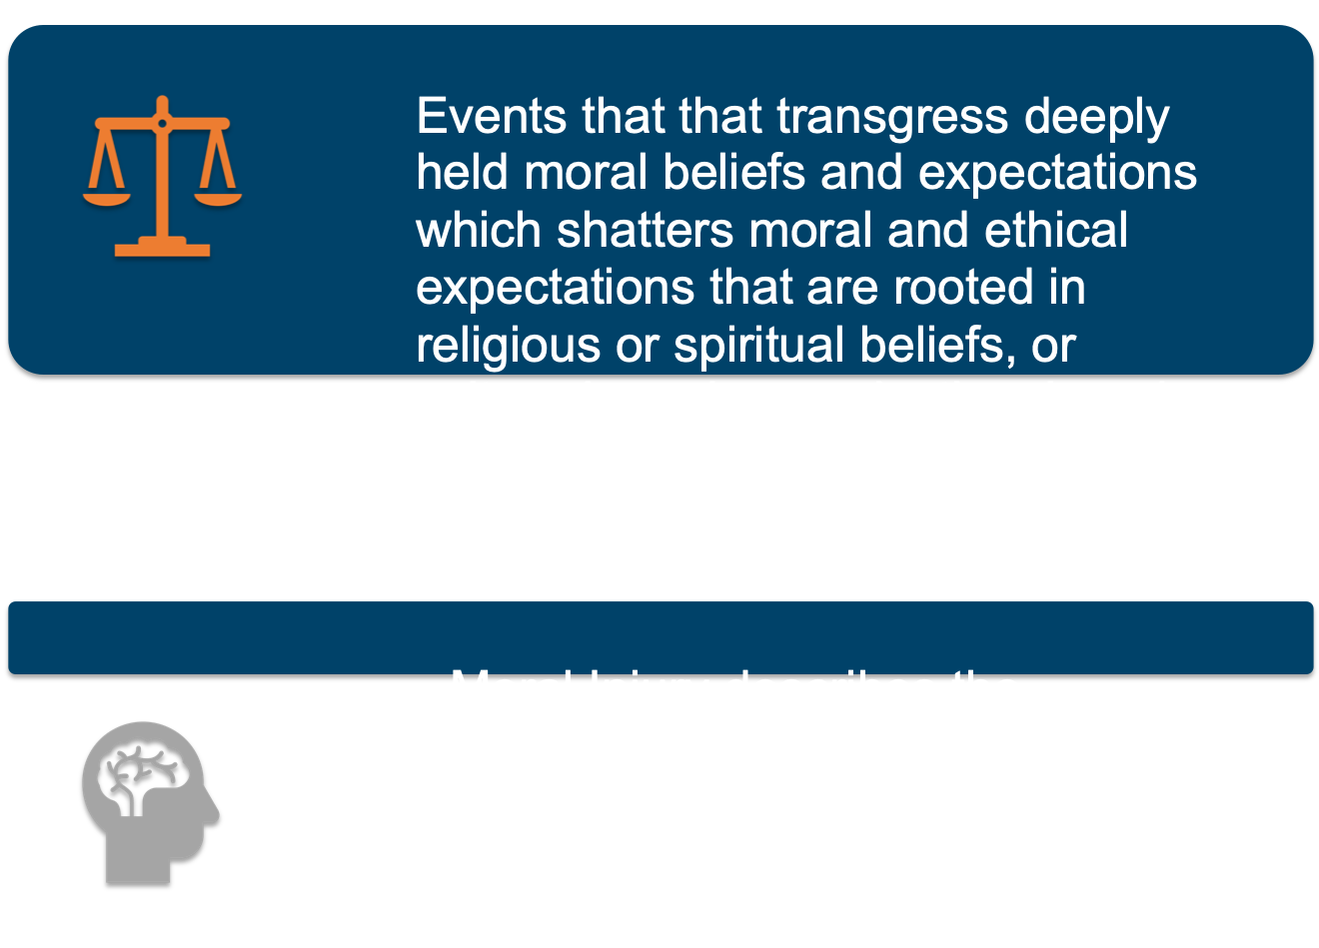
What is Moral Injury?
event occurs where someone’s values
and morals are violated by perpetrating, failing
to prevent, or bearing witness to acts that
transgress deeply held moral beliefs and
values.
The person feels moral pain (involving cognitions and emotions such as guilt or shame) in response to the event.
Moral injury is the lasting psychological,
biological, spiritual, behavioral, and social
Impact of the morally injurious event.
Notes:
NOTE TO SELF: stay away from the word “symptoms” in response to moral injury
The concept of moral injury is a relatively newer concept than PTSD. While the ideas of guilt and shame in relation to wartime experiences have been written about for centuries, we are only in the last decade applying an evidence base and a research perspective to try to understand how to most accurately defined moral injury as well as to most effectively treat moral injury.
There are many definitions of moral injury in the literature today, but one of the definitions that has received the most evidence in terms of mapping onto treatment, is the one that holds that events that are considered morally injuries if they transgress deeply held more beliefs and expectations… Another aspect of this definition is that moral injury describes the harmful psycho – spiritual aftermath of exposure to such events.
These components have also been written about and studied in the PTSD literature for many decades. Guilt and shame have been noted in many research studies related to PTSD, to the degree that the DSM-V includes guilt as one of the core components of PTSD, within the category of negative emotions.
Research indicates that guilt is common following trauma and combat, that it can exacerbate posttraumatic stress, and that it often persists without treatment.
References
Bryan, C. J., Bryan, A. O., Anestis, M. D., Anestis, J. C., Green, B. A., Etienne, N., ... & Ray-Sannerud, B. (2016). Measuring moral injury: Psychometric properties of the moral injury events scale in two military samples. Assessment, 23(5), 557-570.
Litz, B. T., Stein, N., Delaney, E., Lebowitz, L., Nash, W. P., Silva, C., et al. (2009). Moral injury and moral repair in war veterans: A preliminary model and intervention strategy. Clinical Psychology Review, 29, 695-706. doi: 10.1016/j.cpr.2009.07.003.
Litz, B.T., & Schlenger, W.E. (2009). PTSD in service members and new veterans of the Iraq and Afghanistan wars: A bibliography and critique. PTSD Research Quarterly, 20(1), 1-8.
Maguen, S., & Litz,B.T. (2012). Moral Injury in veterans of war. PTSD Research Quarterly, 23(1).
Nash, W., & Litz, B.T. (2013). Moral injury: A mechanism for war-related psychological trauma in military family members. Clinical Child & Family Psychology Review, 16, 365-375.
Nash, W, Carper, T. L., Mills, M.A., Au, T., Goldsmith, A., & Litz, B.T. (2013). Psychometric evaluation of the Moral Injury Events Scale. Military Medicine, 178(6), 646-652.
Shay, J. (2014). Moral injury. Psychoanalytic Psychology, 31(2), 182-191.
Steenkamp, M., Litz, B.T., Hoge, C.W., & Marmar, C.R. (2015). Psychotherapy for military-related PTSD: A review of randomized clinical trial. Journal of the American Medical Association, 314(5), 489-500.
Steenkamp, M., Litz, B.T., Gray, M.J., Lebowitz, L., Nash, W., Conoscenti, L., Amidon, A., & Lang, A. (2011). A brief exposure-based intervention for service members with PTSD. Cognitive and Behavioral Practice, 18, 998-107.
Tick, E. (2014). The Warriors Return. Boulder, CO: Sounds True Inc.
Williamson, V., Greenberg, N., & Murphy, D. (2019). Moral injury in UK armed forces veterans: a qualitative study. European journal of psychotraumatology, 10(1), 1562842.
Frankfurt & Frazier, 2016

Slide 19
Some Veterans feel guilty for NOT killing.
Some have to forgive comrades for unjustifiable acts that the Veteran felt powerless to confront.
Noncombat veterans sometimes feel guilty when they have seen fellow soldiers volunteer for dangerous missions.
Nurses and medics may feel guilty about the life and death decisions they made.
Survivor’s guilt is common; it can interfere with Veterans’ ability to enjoy their lives.
Others have guilt for killing women and children or committing “friendly fire” or intentional killing of perceived poor leaders.
Some feel betrayed by leadership (e.g. command gave negligent orders)
Notes:
So, what do veterans feel guilty about? As was noted earlier guilt can occur via commission of actions or omission of actions. For instance:
Some Veterans feel guilty for NOT killing.
Some have to forgive comrades for unjustifiable acts that the Veteran felt powerless to confront.
Noncombat veterans sometimes feel guilty when they have seen fellow soldiers volunteer for dangerous missions.
Nurses and medics may feel guilty about the life and death decisions they made.
Survivor’s guilt is common; it can interfere with Veterans’ ability to enjoy their lives.
Others have guilt for killing women and children or committing “friendly fire” or intentional killing of perceived poor leaders.
Some feel not guilty but betrayed – for example, feeling betrayed by leadership if they felt that given commands were negligent or led to harm
Other: There have been many experiences written about that could potentially produce moral injury, including:
Perceived betrayal (by peers, leadership, civilians or self), such as being ordered to break rules of engagement, feeling a rush or enjoyment during war/killing, making decisions that affect the survival of others, or beliefs that command gave negligent orders or did not adequately supply troops.
Acts of disproportionate violence inflicted on others, such as mistreating civilians or captured enemy combatants
Incidents involving death or harm to civilians, such as killing children, witnessing or perpetrating violence or sexual abuse on civilians, or disrespecting dead bodies
Within ranks violence
Failing to perform duty during trauma
Feeling rush or enjoyment during trauma
Failing to act
Witnessing harmful act
Wishing you had done something that you didn’t do, such as failing to perform duty, not being able to save fellow service members.
Williamson, V., Greenberg, N., & Murphy, D. (2019). Moral injury in UK armed forces veterans: a qualitative study. European journal of psychotraumatology, 10(1), 1562842.

Slide 20
Moral Injury associated with distress
Difficult emotions
Guilt
Shame
Anger
Disgust
Contempt
Suicidal thoughts and behavior
Depression
Substance use
PTSD
Braitman et al., 2018; Bryan et al., 2018; Farnsworth et al., 2014

Slide 21
Moral injury & PTSD overlap
Moral Injury
PTSD
Event transgresses understanding of morality (often life-threatening)
Often guilt, shame, anger
Usually related to life-threatening events
Often but not always fear-based reaction

Slide 22
Screening: Opening the Conversation

Slide 23
Screening Questions: Starting the Conversation
1). “As people live with serious illnesses, they sometimes experience reminders of prior scary or upsetting events. Has this happened to you?”
2). “Have you felt guilty or bothered about events that previously happened in your life?”

Slide 24
How to Ask and How to Respond
I. Foundation:
1). Be aware of your own “Self in the Room”, logistics, and your feelings about trauma.
2). Screening is part of a larger conversation.
3). How we conduct screening can minimize or maximize the person’s likelihood of accepting any desired care.
4). Leave the person in the position of decision-making.
5). Discussing past trauma, if handled poorly, potentially can retraumatize the person.
6). Be open-minded.
II. Approaches:
1). “I was wondering if you felt like talking with me today? It is ok if not”.
2). If “No”: “That’s all right. Thank you for letting me know. Perhaps another time. Could we could try again _________?”.
Consider if the person might be more comfortable with a different staff member, if this is feasible.
3). If “Yes”: Ensure rapport and transition into the clinical aspects of the discussion.
“We always want to make sure we are meeting the needs of the people for whom we provide care. So, we want to identify those needs as soon as we can. To do that, we ask some questions from time to time about certain various issues and offer to help if we identify any needs”.
“I have some issues I thought we might talk about today. Many people have had experiences in the past that were difficult. I was going to ask about you about any of your past experiences that were painful and whether they still bother you. Is that alright?”

Slide 25
Scenarios
1) The Person Responds “No”:
“Thanks for talking with me. Not everyone has had those kinds of experiences. We just want to identify it if someone has and needs help.”
Make sure the person is comfortable before you disengage.
2) The Person Responds “Yes”:
“Thank you for letting me know that. I know it can take a lot to talk about those kinds of experiences . There is help available here and at the VA, if you would like that. There are staff at the VA who specialize in helping with these kinds of issues and we can access that care for you. The treatments available these days are state-of-the- art.”
“Not everyone wants to address these experiences, though, and that is all right, too. Sometimes people consider it a part of the past and do not want to bring it back up again. What do you think is best for you? If you want to think about it, I am always glad to come back again”.
“Are there things we can do here to support you? For example, are there things you want us to know about how these experiences affect you? Are there things we need to do differently in how we go about your day-to-day care? If you seem upset, is it helpful for someone to ask you about it? Or, is it better just to give you “space”?
Explain how the Veteran can access immediate support in your given setting if needed urgently.

Slide 26
Scenarios (continued)
3) Silence:
Can be due to emotional reasons, cognitive reasons, medical reasons, etc.
Sit with the person for a little bit, tolerate the silence, reassure yourself that you did not do anything wrong.
After a bit, “I know these things can be hard and I don’t mean to push in any way. Would you like me to come back?”
If “Yes”:
“I’m glad to. I’ll see you again in _____. “
Make sure the person is comfortable and ok before you go.
If “No”:
“That’s all right. If you change your mind, I am always glad to talk with you. There is help available through the VA, too, and we can access that for you if you would like”.
Make sure the person is comfortable and ok before you go.
Ensure staff keep a quiet eye on the Veteran for a few days after.

Slide 27
Scenarios (continued)
The Person Becomes Upset:
Address any immediate needs that may be contributory: Pain, etc.
“I know these experiences can be upsetting to think about. Is it best for you to push through? Or, is it better to leave that topic and just focus on helping you calm and feel better now?”
If the person wants to “push through”, follow the process discussed previously, but also be prepared to provide all needed psychological first aid as well.
Are there other staff who might be helpful if available (e.g. Nurse, Chaplain, etc.), who could respond as well, either at the time or in the future?
“Would you like me to also ask _______________ to help us as well?”
Engage in calming activities (new topic of conversation, music, TV, relaxation exercise, etc).

Slide 28
Care for the Staff
Always remember that these are painful topics to discuss and staff members can feel that, especially over time as they talk to more and more Veterans.
Get the support you need.

Slide 29
Assessment

Slide 30
PTSD Screening and Symptom severity
Selected Validated PTSD Instruments
PC-PTSD-5
5 item
PCL-5
20 item
Self-report
Screen and monitor PTSD
Self-report
Screen for PTSD in Primary Care
5-10 minutes
Positive if 3 or more YES responses
33 cut-point score
PC-PTSD-5: www.ptsd.va.gov/professional/assessment/screens/pc-ptsd.asp
PCL-5: www.ptsd.va.gov/professional/assessment/adult-sr/ptsd-checklist.asp
Life Events Checklist: https://www.ptsd.va.gov/professional/assessment/te-measures/life_events_checklist.asp
30
Notes:
These screens and symptom severity measures can be used as a follow up of the question “As people live with serious illness, they sometimes experience reminders of prior scary or upsetting events. Has this happened to you?” … to get a better sense of the full picture of how trauma or PTSD may have affected someone, and the current symptom burden.
Also consider: comprehensive chart review (especially when illness prevents patients from sharing history with you), speaking with family members (Glick et al., 2018).
SCOTT’S suggestions: include the 5 questions of the PC-PTSD – what kind of answers might you get, how to help back them into an appropriate answer if you’re not getting what you need. (Consider audience being a new hospice nurse with very little experience with these measures)
I’ve included here a couple of self-report measures for assessment of PTSD – one very brief (to be used in Primary Care or other places one would want a quick screen), one slightly longer (which maps onto all the symptoms of PTSD as outlined in the DSM-5).
The reason we suggest using these is that we’ve seen that very very often, people will NOT report trauma or PTSD symptoms unless directly asked. So we can’t wait on people to come forward. Also, PTSD can emerge in later life so it’s important to re-assess. And, PTSD symptoms are not always obvious, or they can masquerade as other things. For instance, I worked with one patient who drank heavily to avoid thinking about a trauma – for decades, people around him only noticed the drinking, not the PTSD – and it wasn’t until someone asked about trauma (a few times) that it came up [[can give example of porn viewing]]. Likewise, often PTSD can just look like the observable signs such as anger or insomnia or nightmares, which wouldn’t necessarily be obvious as a sign of PTSD to the lay person.
We’ve also seen that older adults with newly diagnosed PTSD tend to be less likely to get treatment for it than younger adults – so again, unless we’re asking, we won’t know and can’t offer treatment. Or we may blame patients for angry outbursts, or give medications, when what might be more helpful is trauma-focused therapy, or a trauma-informed care approach.
This information will be helpful if you’re referring to VA mental health – having a score on the PCPTSD or PCL will be more easily interpretable to them in terms of symptom severity
(Smith, Cook, Pietrzak, Harpaz-Rotem 2015
From https://journals.sagepub.com/doi/full/10.1177/1049909118756656

Slide 31
PC-PTSD-5
In the past month, have you... Had nightmares about the event(s) or thought about the event(s) when you did not want to? YES/NO Tried hard not to think about the event(s) or went out of your way to avoid situations that reminded you of the event(s)? YES/NO Been constantly on guard, watchful, or easily startled? YES/NO Felt numb or detached from people, activities, or your surroundings? YES / NO Felt guilty or unable to stop blaming yourself or others for the event(s) or any problems the event(s) may have caused? YES/NO
31
Notes:
Just to give you a sense of one of these screens, this is the shorter one. After assessing for trauma, you would ask these five questions.
For nightmares, you’re looking for things like a direct replay of a trauma – or something thematically related (not a general distressing dream)
For avoidance, often this looks like never having talked about the event. Or it can also look like avoiding things that remind you of a trauma (often this is something like crowds).
The third one can look like easy startle response (that is really more than normal – everyone would be expected to have SOME startle response), or being overly watchful – like feeling that you can’t sit in a restaurant with your back to the exit, or always having to scan a setting to see where the exits are in case of danger.
For feeling numb or detached, we’re really looking for ways that they’re not engaging socially or can’t feel their normal feelings anymore. And this should be related to the trauma – if this just started happening after retirement, for instance, or if they’ve felt this their whole life, then it may not be trauma-related.
For the guilt question, we’re not talking about appropriately blaming the perpetrator here… rather we’re getting at blame that DOESN’T make sense – like a survivor of assault blaming themselves for having trusted the perpetrator, or a someone blaming a leader who led them into an ambush – rather than blaming the person who launched the ambush.

Slide 32
Moral injury assessment
Less consensus in this area
32
Notes:
Unlike PTSD, there is little consensus around how best to assess for moral injury – and remember, that differs depending on whether you’re trying to get an overview of event types, or the reaction to those events. We’re going to leave you with some resources so that you have a few to choose from.

Slide 33
Moral Injury Events Scale (Nash et al., 2013)
Perpetration Other Subscale
I saw things that were morally wrong
Perpetration Self Subscale
I am troubled by having acted in ways that violated my own morals or values
I violated my own morals by failing to do something that I felt I should have done
Betrayal Subscale
I feel betrayed by leaders who I once trusted
33
Notes:
But in the meantime, I wanted to show you at least one of these scale. The Moral Injury Events Scale is one of the more commonly studied.
This will give you a sense of some of the questions on this subscale. Like many, it is centered around a military context, so it may not adequately capture moral injury in other contexts.
While there is no consensus around how to interpret a particular score on this scale, you will see that the information from it gives a lot of rich clinical information and could be enough to start a conversation around what would be helpful to the person, and how distressing this is.

Slide 34
When to refer?

Slide 35
PTSD and moral injury SEVERITY and impact
Less impact
Sometimes thinks about a trauma
Reluctant to discuss a trauma
At times down or irritable
Seems more “jumpy” than others
Expresses regret about actions taken
Notes:
The scales I discussed will give you a sense of severity and help to communicate to others how “bad” things are. Just to give you a brief sense of severity, I want to show a spectrum of various symptoms. On the lower end of the spectrum are more likely to be those symptoms or reactions that can be responded to internally, whereas at the higher end of the spectrum are those that might lead you to consider a consult with the PTSD Consultation Program or a referral. All of that is dependent on internal resources of the group you’re working with, as well as the veteran’s interest in care related to this topic, which leads us into the next part of our talk.

Slide 36
PTSD and moral injury SEVERITY and impact
Less impact | More impact
Sometimes thinks about a trauma | Frequently distracted by vivid images of a trauma
Reluctant to discuss a trauma | Actively avoids anything that will remind of a trauma, refuses to discuss
At times down or irritable | Unable to have or express loving feelings toward others, hates self
Seems more “jumpy” than others | Becomes easily startled, leading to scanning the environment for threats and becoming violent in response to perceived threats
Expresses regret about actions taken | Unbearable guilt and shame at actions taken
Notes:
The scales I discussed will give you a sense of severity and help to communicate to others how “bad” things are. Just to give you a brief sense of severity, I want to show a spectrum of various symptoms. On the lower end of the spectrum are more likely to be those symptoms or reactions that can be responded to internally, whereas at the higher end of the spectrum are those that might lead you to consider a consult with the PTSD Consultation Program or a referral. All of that is dependent on internal resources of the group you’re working with, as well as the veteran’s interest in care related to this topic, which leads us into the next part of our talk.

Slide 37
Considerations for when to refer to VA:
Does the veteran want to address PTSD or moral injury?
Is symptom severity on the more severe end (e.g., PCL over 33)?
Are symptoms causing significant distress to the veteran or disruption to others?
If yes to any of the above, first try interventions such as active listening, relaxation and environmental changes. Consider engaging others on the hospice team with more expertise in trauma informed care.
Does your team feel overwhelmed and ill-equipped to treat this Veteran’s degree of trauma or moral injury?
Have initial interventions by your team failed to adequately help?
If yes to one of the first two questions and to the last two questions, then try:
Moderate need: PTSD Consultation (for more immediate response to help the team intervene) – also appropriate if the team has identified a concern but veteran is uninterested in treatment
High need: VA Telemental health (to connect the veteran with a trained VA provider)
Consider both these options to help the patient access help and the team provide better care
Notes:
We wanted to outline when you might consider different options for help.
The first question to ask is – does the veteran WANT to address PTSD or moral injury? If not, then this point in life is not the time to push the issue. If they do – even if it doesn’t seem like symptoms are severe – go ahead and make the referral.

Slide 38
Connecting to VA Resources

Slide 39
Connecting to VA Resources
VA enrollment not required
PTSD Consultation Program- email or phone
Crisis Line
Enrollment Required
VA Telemental Health

Slide 40
Veterans Crisis Line
Connect with the Veterans Crisis Line to reach caring, qualified responders with the Department of Veterans Affairs. Many of them are Veterans themselves
Call 1-800-273-8255 and Press 1
Text 838255
Chat - Connect online https://www.veteranscrisisline.net/get-help/chat
Support for deaf and hard of hearing - For TTY users: Use your preferred relay service, or dial 711 then 1-800-273-8255. Or chat with us.
This free support is
Confidential
Available every day, 24/7
And serves
All Veterans
All Service members
National Guard and Reserve
Their family members and friends
FG

Slide 41
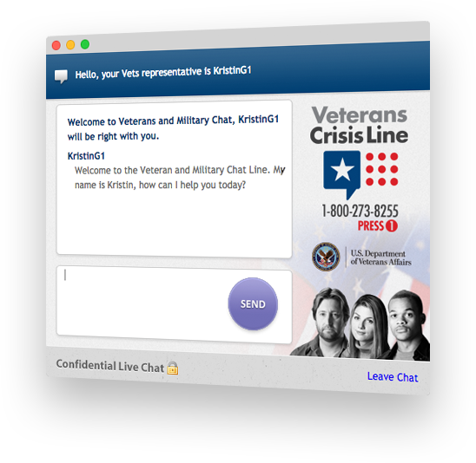
Crisis Chat
The crisis chat is a free, anonymous, confidential resource that is available to any Service member, including members of the National Guard and Reserve, and any Veteran, even if not registered with VA or enrolled in VA health care. Someone concerned about a Veteran in crisis may also use this support.
A responder will answer and ask you a few questions. This responder will work with you to help you through any personal crisis, even if that crisis does not involve thoughts of suicide.
Examples of caller topics include chronic pain, anxiety, depression, sleeplessness, anger, disturbing memories of tour of duty
FG

Slide 42
Applying for VA Healthcare What Information is needed
Social Security numbers for Veteran, Veteran’s spouse, and qualified dependents.
Military discharge information. A copy of the DD214 or other separation documents.
Insurance cards for all health insurance companies that cover Veteran. This includes any coverage through a spouse or significant other; Medicare; private insurance; or insurance from Veteran’s employer.
(Optional) Last year’s gross household income for Veteran, spouse, and dependents. This includes income from a job and any other sources. Gross household income is the income before taxes and any other deductions.
(Optional) Deductible expenses for last year. These include certain health care and education costs. These expenses will lower the amount of money we count as income.

Slide 43
Applying for VA Healthcare
Apply online: Apply For Health Care | Veterans Affairs (va.gov) https://www.va.gov/health-care/apply/application/introduction
Apply by phone Call our toll-free hotline at 877-222-8387, Monday through Friday, 8:00 a.m. to 8:00 p.m. ET to get help with your application.
Apply by mail Fill out an Application for Health Benefits (VA Form 10-10EZ). Download VA Form 10-10EZ (PDF)
Send your completed application here:
Health Eligibility Center 2957 Clairmont Rd., Suite 200 Atlanta, GA 30329

Slide 44

PTSD Consultation Program We are here to help
Healthcare Providers:
Are you treating Veterans with PTSD? We can help
Do you have questions about the mental health effects of the COVID-19 pandemic? We can help
Are you looking for ways to care for yourself and your colleagues? We can help
PTSDconsult@va.gov
866-948-7880
www.ptsd.va.gov/consult
FG

Slide 45

PTSD Consultation program for providers treating veterans
FG

Slide 46
PTSD consultation program
Mission and Scope
The mission of the National Center for PTSD is to advance the clinical care and social welfare of America's Veterans and others who have experienced trauma, or who suffer from PTSD, through research, education, and training in the science, diagnosis, and treatment of PTSD and stress-related disorders.
The goal of the PTSD Consultation Program is to improve the care available to all Veterans with PTSD regardless of where they access services. We offer expert guidance on general issues that come up in the course of caring for Veterans with PTSD.
We cannot, however, provide direct guidance or consultation regarding or assume clinical responsibility for specific patients; any potential liability would be only in accordance with the Federal Tort Claims Act.
FG

Slide 47

PTSD Consultation Program: FAQ (Videos)
Can the PTSD Consultation Program Be Helpful to Me?
PTSD Consultation Program: FAQ (Videos) - PTSD: National Center for PTSD (va.gov)
https://www.ptsd.va.gov/professional/consult/faq.asp
This Photo by Unknown Author is licensed under CC BY-NC-ND

Slide 48
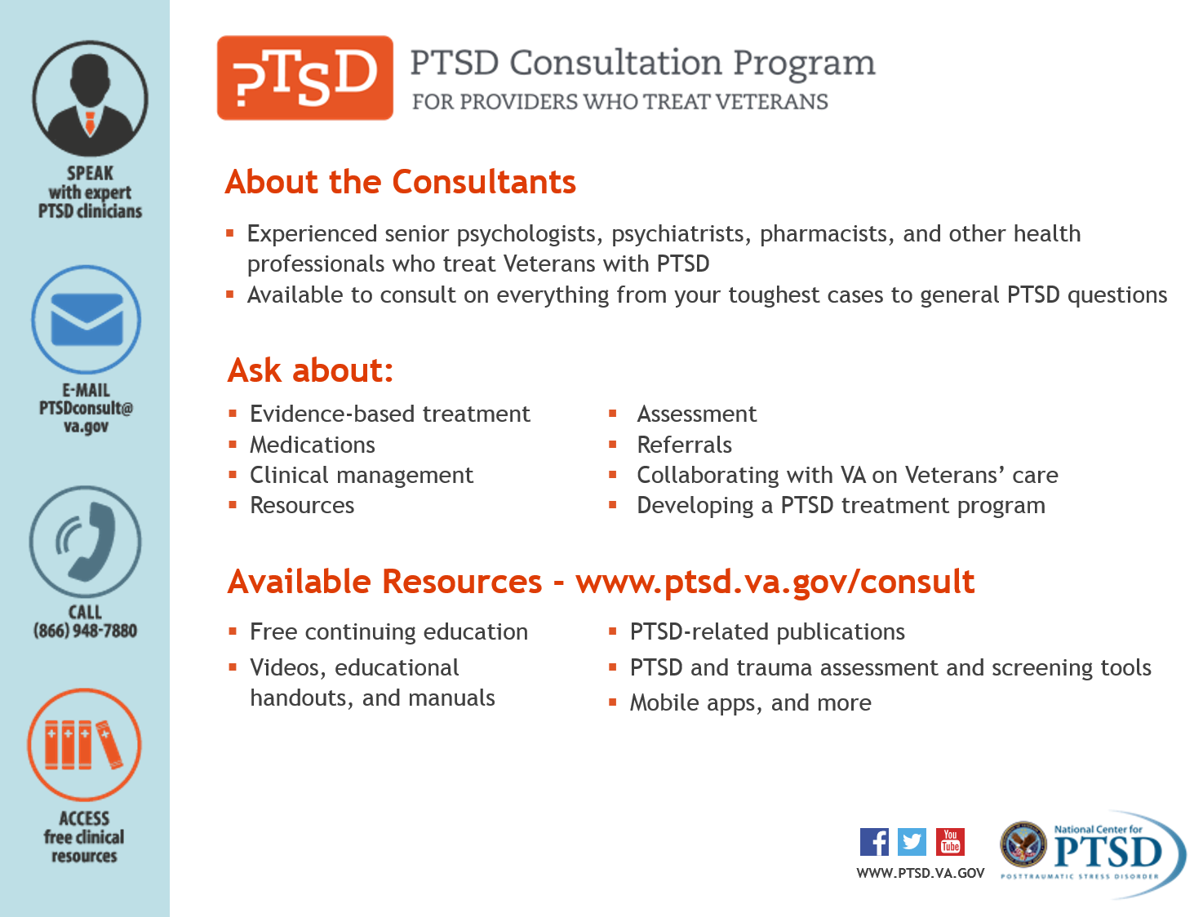
FG
Notes:
This is the resource information for the PTSD consultation program which is available to any provider within and outside of the VA.

Slide 49
Accessing Telemental Health
VA offers telehealth services across the U.S. — including via VA Video Connect — an app that promotes “Anywhere to Anywhere” care.
Veterans will need to be enrolled to receive VA telehealth services which can be initiated online at the link below or by calling 877-222-VETS (8387). https://www.va.gov/healthbenefits/online/
Telemental Health Hubs connect mental health specialists with Veterans at sites who require same-day or urgent access to mental health services. www.telehealth.va.gov
For Veterans enrolled in the VA Healthcare System, the VA Facility locator may help you find their Primary Care Team. Other facility types are also listed, including VA Cemeteries Find VA Locations | Veterans Affairs https://www.va.gov/find-locations/
FG
Notes:
Referring back to the case, if a hospice agency needed to facilitate access to telemental health for a Veteran, these are resources to help meet that need.

Slide 50

VA Digital Divide Consult
Bridging the Digital Divide | Telehealth VA - https://telehealth.va.gov/digital-divide
FG

Slide 51
Polling question

Slide 52
We thank the VA members of our workgroup:
Sadie Larsen, Robyn Walser, Fanta Gibson, Jordana Meyerson, Douglas Lane, Donna Ames, James Ratsch, Geoffrey Tyrrell, Amelia Anthony, Ryan Weller, Chad Maxey and Scott Shreve.
And the contributing Community Hospice partners:
Katherine Kemp, Amanda Anderson and Paige Hector
Thank you, our audience!
Questions or comments?

