Slide 1

Supporting military veterans with PTSD at the end of life: Video illustrations

Slide 2
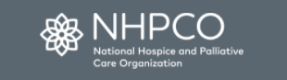
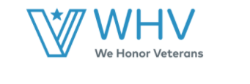


Thank you
Hospice and Palliative Care Clinicians who provided insights via NHPCO survey and our focus groups
VA Program for Hospice and Palliative Care

Slide 3
our team
Jennifer Moye, PhD
Geropsychologist
Assoc. Director Education and Evaluation, New England GRECC
Anica Pless Kaiser, PhD
Psychologist
Investigator, National Center for PTSD, Behavioral Science Division
Zachary Sager, MD
Hospice & Palliative Care Physician and Psychiatrist
GRECC & Division of Geri/ Pall
Kelly O’Malley, PhD
Geropsychologist
VA Boston CLC
Lynn Korsun, BS
Project Manager
National Center for PTSD, Behavioral Science Division
Anna Etchin, RN, PhD
Nurse Researcher
Fellow, Translational Research Center for TBI and Stress Disorders
Rachel Weiskittle, PhD
Geropsychologist
Fellow, New England GRECC
Hannah Bashian, M.Ed
Geropsychology Intern
VA Boston

Slide 4
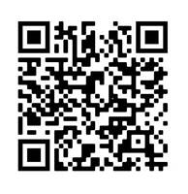
3 Videos
Tech Tips
PERSONAL TIPS
Reduce home bandwidth (e.g., close internet tabs, turn off other videos/ streaming)
If problems, open separately in google
These videos show veterans discussing or re-experiencing trauma and show compassionate care by hospice and palliative care clinicians.
While not graphic in nature, the videos may be emotionally evocative.
QR Code for YouTube Playlist

Slide 5
Video 1
Look for:
Signs and Symptoms of PTSD

Slide 6


Slide 7
Video 1 – Discussion
Have you experienced this?
How else have you seen PTSD present?

Slide 8
Video 2
Look for:
What do you think the nurse is doing in her response?

Slide 9


Slide 10
Video 2 – Discussion
What do you think she is doing well?
What do you find hard in such situations?

Slide 11
Video 3
Look for:
What do you think the nurse is doing in his response?

Slide 12


Slide 13
Video 3 – Discussion
What skills is Chad applying?
What else have you tried in such situations?

Slide 14
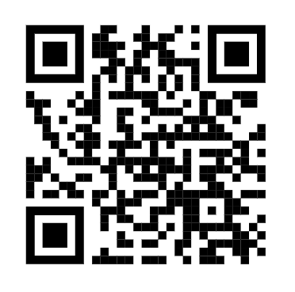
What did you think? What should we do next?
Take out your smart phone
Open camera & start to take picture of QR code
It should take you to our 6-item feedback survey
Or see link in chat
Or answer questions in chat
QR Code for Survey to provide feedback

Slide 15
Thank you
Questions

Slide 16
Extra slides if needed

Slide 17
3 VIDEOS ABOUT 2 VETERANS
Les, (Married)
VN “Tunnel Rat” with COPD, Cognitive Impairment, Flashbacks
Helen, (Single)
VN Nurse with Cancer and avoidance

Slide 18
TRAUMA EXPOSURE
In general population,
50% to 90% of older adults have been exposed to at least 1 potentially traumatic event in their lifetime
In veteran population,
On average, older adults have experienced of 3 traumatic events in their lifetime
National Health and Resilience in Veterans Study, Creamer & Parslow (2008); Pietrzak & Cook, 2013; Spitzer et al. (2008); Forman-Hoffman et al. (2012); Monson, Lonergan, Caron, & Brunet (2016).

Slide 19
POSTTRAUMATIC STRESS DISORDER (PTSD)
Re-experiencing
Avoidance
Negative Cognitions and Mood
Arousal
Traumatic Experience +
> 1 month and cause clinically significant distress or functional impairment
Notes:
Re-experiencing
Intrusive memories, dreams, dissociative reactions (flashbacks), psychological distress, psychological reactions to trauma reminders
Avoidance
of distressing memories, thoughts, feelings or external reminders (people, places, situations)
Negative cognitions and mood
Inability to remember, blame, distorted cognitions, persistent negative emotion and beliefs, disinterest, estrangement, emotional numbing
Arousal
Irritable, self destructive behaviors, hyper-vigilance, exaggerated startle, problems concentration, insomnia

Slide 20
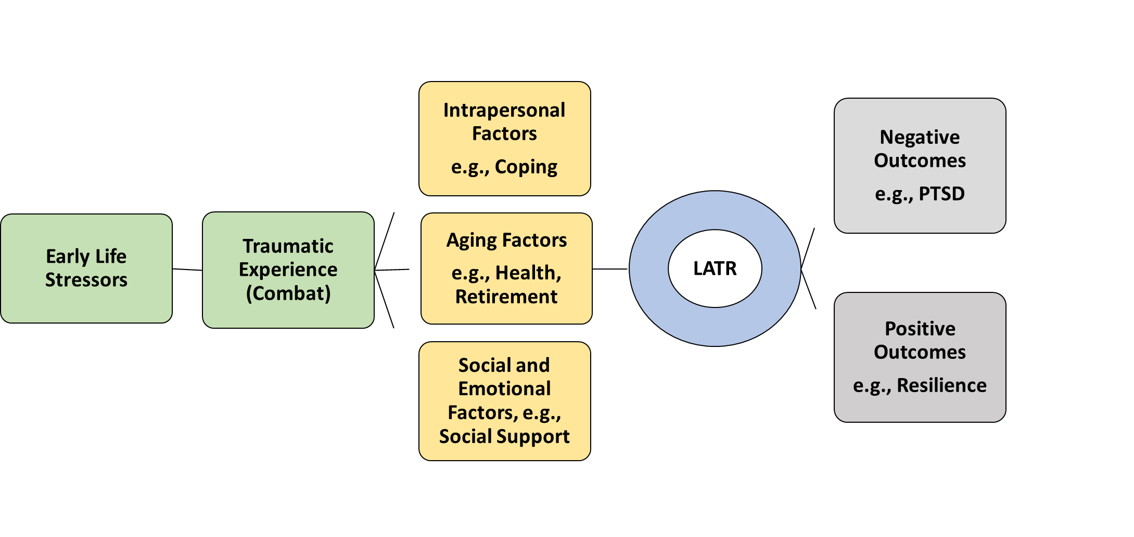
LATER ADULTHOOD TRAUMA RE-ENGAGEMENT (LATR)

Slide 21
Our Starting Place: NHPCO Survey (N=157) & Focus Groups (N=97)
Cluster | % | Qual - More common | Qual - Less Common
Re-experiencing the emotions of combat | 27% | Memories Dreams/ nightmares Flashbacks Emotional upset | Phys Rxn
Avoidance of trauma reminders | 24% | Avoid reminders | Avoidance memories
Negative beliefs about self, others, world | 19% | Negative beliefs, distrust Fear, horror, guilt, shame Blame Feeling cut off | Trouble remembering Loss of interest Unable to have positive feelings
Elevated Arousal | 25% | Irritable/ angry Can’t sleep Super-alert | Risky behavior Jumpy/startled Can’t concentrate
Other | 6% | Isolating/ reclusive / Stoic Family conflict Telling stories

